Slide 1
MGMT 3070
Organizational Behavior and Management
Timothy McCallion
Lecturer

Slide 2
Management
What is Management?
  A process of getting things done efficiently and effectively with and through others.
  Efficiency – Getting work done with a minimum of effort, expense, or waste (quickly, input vs. output)
  Effectiveness – accomplishing tasks that help fulfill organizational objectives (goals)

Slide 3
Management
Peter Drucker – was a well known writer, professor, and management consultant.
  “Management is doing things right; leadership is doing the right things”
Stephen Covey – was an educator, author, businessman.
  “Effective leadership is putting first thing first. Effective management is discipline carrying it out”.
Business Dictionary
  The organization and coordination of the activities of a business in order to achieve defined objectives.

Slide 4
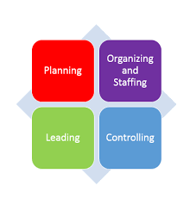
The Four Functions of Management

Slide 5
Organizational Behavior
  Organizational behavior (OB) is the study of the way people interact within groups. Normally this study is applied in an attempt to create more efficient business organizations. The central idea of the study of organizational behavior is that a scientific approach can be applied to the management of workers. Organizational behavior theories are used for human resource purposes to maximize the output from individual group members. (Investopedia)
  There are a variety of different models and philosophies of organizational behavior. Areas of research include improving job performance, increasing job satisfaction, promoting innovation and encouraging leadership. In order to achieve the desired results, managers may adopt different tactics, including reorganizing groups, modifying compensation structures and changing the way performance is evaluated.

Slide 6
Management - What do managers do?
  Planning – Determining organizational goals and a means for achieving them.
  Organizing – Deciding where decisions will be made, who will do what jobs and tasks, and who will work for whom.
  Leading – Inspiring and motivating workers to work hard to achieve organizational goals.
  Controlling – Monitoring progress toward goal achievement and taking corrective action when needed.
Notes:
Note that three of the four things that managers do involve goals.

Slide 7
Management - Kinds of Managers
  Top Managers – Executives responsible for the overall direction of the organization. “C” level, Chief Executive Officer; Chief Financial Office; Chief Legal Officer; Chief Technology Officer; some Vice Presidents
  Middle Managers – Sets objectives consistent with top managements goals and for planning and implementing subunit strategies for achieving these objectives. Plant Manager; Division Manager; Region Manager; some Vice Presidents
  First Line Managers –Supervise non-managerial employees. Shift Supervisor; Office Manager; Department Managers
  Team Leaders – Facilitates team activities
Notes:
Some organizations bestow VP titles on middle managers. This is common in financial institutions and external facing jobs with utilities, entertainment industry, and banks.
Example of shift supervisor – Starbucks, McDonalds, Manufacturing Plant, Delivery Service, etc..

Slide 8
Management - Roles
  Interpersonal Roles – Management jobs are people intensive.
    Figurehead - Representing the company
    Leader - Motivate and encourage employees.
    Liaison - Dealing with people outside their units including serving on other Boards of Directors
Notes:
Some example:
Figurehead role – Representing the company: with stakeholders; on the Chamber of Commerce; attend non profit event; Give some personal examples: public hearings;
Leadership role – Motivate and encourage employees. Personal example like the trip up north w/ Margaret after the fires.
Liaison role – Dealing with people outside their units including serving on other Boards of Directors.

Slide 9
Management - Informational Roles
  Monitor role – scan their environment for information
  Disseminator role – share information with others in their departments or companies.
  Spokesperson role – share information with people outside their departments or companies.
Notes:
In the spokesperson role managers must be very careful to following all rules related to inside information and SEC disclosure rules and reporting requirements for example 8K.

Slide 10
Management
Decisional role – Obtaining and sharing information isn’t enough
  Entrepreneur role – adapt themselves, their subordinates, and their units to change.
  Disturbance handler – respond to severe pressures and problems that demand immediate action.
  Resource allocator – decide who gets what resources and in what amounts.
  Negotiator role – negotiate schedules, projects, goals, outcomes, resources, and employee raises
Notes:
Disturbance handler -- Leaders go to where the trouble is, they don’t avoid trouble.
Resource allocators – For example, the CEO’s of Verizon and AT&T have to decide whether to allocated capital to landline business, wireless business, or to new business enterprises. How much to each? What are the benefits and detriments to stakeholders. No matter how they allocate capital, a scarce and limited resource, they will face criticism.

Slide 11
Management - Skills
  Technical skills – specialized procedures, techniques, and knowledge required to get the job done.
  Human skills – work well with others
  Conceptual skills – see the organization as a whole, understand how the different parts affect each other, and recognize how the company fits into or is affected by its environment.
  Motivation to manage – how enthusiastic employees are about managing the work of others. (Many people are great specialists but not great managers).
Notes:
Technical skills are especially important for lower level managers as they supervise workers who produce products or serve customers. They may become less important as managers rise through the ranks.

Slide 12
Management
Mistakes Managers make
  What have you observed?
  A top 10 list is shown on page 16 of the text
Competitive Advantage Through People
  Top companies treat their people well – what are some examples?
  Satisfied employees = Satisfied customers
  Millennials want meaningful work
Transition to Management – the toughest thing is to transition away from the skill set that got you prompted (technical or professional) to another skill (people development)
Notes:
Google; Facebook; Starbucks; Costco; Cheesecake Factory
Companies that are criticized for the way they treat employees: Walmart; Agricultural industry; Garment industry

Slide 13
The History of Management
Ideas and practices through history – systematic changes in the nature of work and organizations created the need for managers.
  Industrial Revolution – machines replaced individual work
  New ways of working – Ford’s assembly lines dramatically increased productivity
Scientific Management – thoroughly studying and testing different work methods to identify the best, most efficient way to complete a job.
  Father of Scientific Management – Fredrick Taylor (1856-1915)
    Soldering – when workers deliberately slow their pace or restrict their work output.
    Rate Buster – a group member whose work pace is significantly faster than the normal pace in his or her group.
Notes:
Video 10:30 but stop at Deming 7:30 minutes.
Why do we need managers today?
Industrial Revolution began in Great Britain about 1760. Brought about by technological change.
Scientific Management – My experience (piece work / time study) with Inland Container Corp and Kaiser Aluminum
Examples of soldering -

Slide 14

The History Of Management
Taylor’s Four Principles of Scientific Management
  Develop a science for each element of a man’s (persons) work, which replaces the old rule of thumb method.
  Scientifically select and then train, teach, and develop the workman, whereas in the past, he chose his own work and trained himself as best he could.
  Heartily cooperate with the men (women) so as to insure all of the work being done is in accordance with the principles of the science that has been developed.
  There is an almost equal division of the work and the responsibility between the management and the workmen (workwomen). The management take over all of the work for which they are better fitted than the workmen, while in the past, almost all of the work and the greater part of the responsibility were thrown upon the men.
Notes:
The purpose of the fourth goal is to align the interests of management and employees.

Slide 15
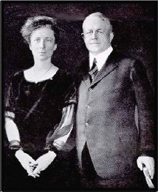
The History of Management
Motion studies: Frank and Lillian Gilbreth
  Motion study – breaking each task or job into its separate motions and then eliminating those that are unnecessary or repetitive.
  Time study – timing how long it takes good workers to complete each part of their jobs.
Gantt Chart – a graphical chart that shows which tasks must be completed at which times in order to complete a project or task.
  Developed by Henry Gantt
  Used for many projects
  What are some examples of work that would be aided by Gantt charts?
Notes:
Gantt Chart:
Construction – office buildings, homes, swimming pools
Manufacturing – computers, cars,

Slide 16
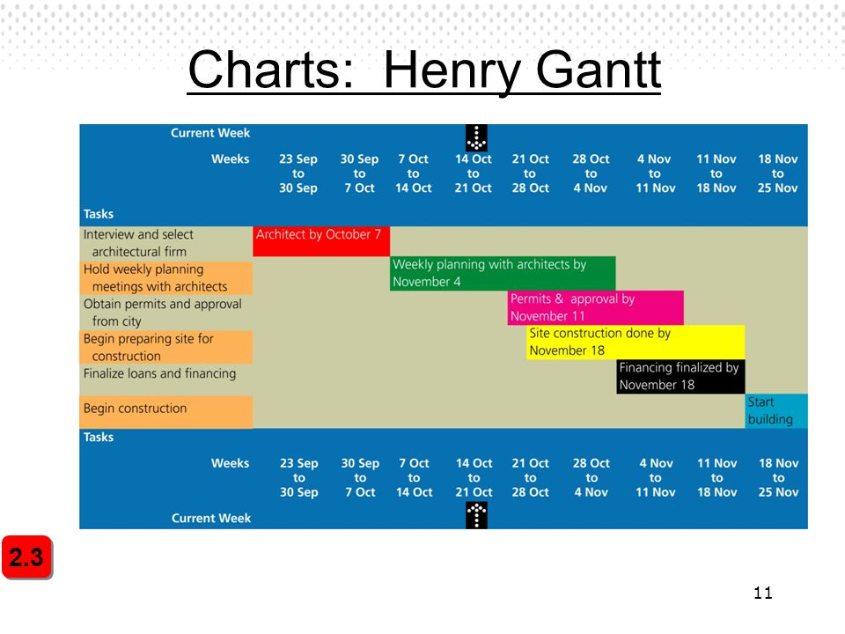

Slide 17
The History of Management
Bureaucracy – The exercise of control on the basis of knowledge, expertise or experience. (A replaced for favoritism or connections)
Elements of a bureaucratic organization – Max Webber (1864-1920)
  Qualification base hiring
  Merit-based promotion
  Chain of command
  Division of labor
  Impartial application of rules and procedures
  Recorded in writing
  Managers separate from owners
Notes:
Today bureaucracy has a negative connotation such as delay, red tape, etc., but that as not its original meaning. It comes from the French word “bureaucratie” (to rule from a desk)
Max Weber was a German sociologist.

Slide 18
The History of Management
Administrative MGMT – Henri Fayol (1841-1925)
Fayol’s Fourteen Principles of Management (Exhibit 2.5)
  Division of Work
  Authority and Responsibility
  Discipline
  Unity of command
  Unity of direction
  Subordination of individual interests to the general interest
  Remuneration
Notes:
Fayol was a Frenchman, who took over as the CEO of a vertically integrated French steel company. He was told to shut the business down because of its poor productivity. Instead he turned it around using what later became his 14 Principles of Management. They are explained in Exhibit 2.5. (P33).

Slide 19
The History of Management
Fayol’s Fourteen Principles of Management (continued)
8) Centralization
9) Scalar chain (each position is part of the chain)
10) Order
11) Equity
12) Stability of tenure of personnel
13) Initiative
14) Esprit de Corps (morale and unity among workers)

Slide 20
The History of Management
Human Relations Management
HRM - Organizational success depends on treating people well.
Constructive conflict: Mary Parker Follett (1868-1933)
  Domination – an approach dealing with conflict in which one party satisfies its desires and objectives at the expense of the other party’s desires and objectives.
  Compromise – an approach to dealing with conflict in which both parties give up some of what they wanted in order to reach agreement on a plan to reduce or settle the conflict.
  Integrative conflict resolution – an approach to dealing with conflict in which both parties indicate their preferences and then work together to find an alternative that meets the needs of both.
Notes:
What are the problems with the domination approach? – i.e.., could lead to a bad outcome; organization may not “buy in” to the solution
What are the problems with the compromise approach? – i.e.., organization may “buy in” to a bad outcome; both parties may be unhappy with the compromise
What are the problems with Integrative conflict resolution? - i.e.., takes more time that other approaches

Slide 21
The History of Management
Hawthorne Studies (1924-1932): Elton Mayo (1880-1948)
  Conducted over eight years at Western Electric plant in Chicago
  Studied the impact of the levels of lighting and incentives on employee productivity in the Relay Test Assembly Room.
  Production levels increased when experimenters increased the levels of lighting
  Production levels increased when the experimenters subsequently decreased the level of lighting
  Production levels increased when various changes were made to compensation based upon individual or group production
  Throughout the five year study production levels increased (2400 relays per day to 3000 relays per day).
Notes:
Besides lighting, financial incentives and rest pauses (breaks) were also changed to determine the impact on productivity.

Slide 22
The History of Management
Hawthorne Effect
  Incorrectly defined as increasing productivity by paying more attention to workers.
  Workers feeling and attitudes affected their work.
  Mayo concluded based upon other Hawthorne tests (Bank Wiring Room) that “ work was done in accord with the group’s conception of a day’s work; this was exceeded by only one individual who was cordially disliked”.
  Hawthorne conclusion: Workers are not just extensions of machines, and that financial incentives weren’t necessarily the most important motivator for workers.
Notes:
Thanks to these studies Managers better understand the effect that social interactions, employee satisfaction, and attitudes had on individual and group performance.

Slide 23
The History of Management
Acceptance theory of authority (Chester Barnard)
  Organization – a system of consciously coordinated activities or forces created by two or more people. Organizations occur whenever two or more people work together for some purpose.
  Cooperation is not the normal state of affairs according to Barnard.
  People cooperate within an organization based upon how people perceive authority and whether they are willing to accept it. Directives need to be: understood; consistent with the purpose of the organization; compatible with peoples personal interests; can actually be carried out by those people.
  Ask people to do things contrary to the organization’s purpose or their own benefit and they will put up a fight.
Notes:
Barnard worked for AT&T and published a now classic book on Management : Functions of the Executive

Slide 24

The History of Management
Operations Management – A quantitative or mathematical approach to find ways to increase productivity, improve quality, and manage or reduce costly inventories. Early application (Eli Whitney) – interchangeable parts for muskets for the early US Government. Now used throughout manufacturing.
Information Management – speed up the access to timely information. First technologies to revolutionize business information management were paper and the printing press. Later came: telegraph, telephone, internet
Notes:
Eli Whitney, who later became famous for the Cotton Gin, determined if gun parts were made accurately enough guns could be made with standardized, interchangeable parts. He demonstrated the advantage of interchangeable parts to Thomas Jefferson in 1801.

Slide 25
The History of Management
Systems Management – Looking for connections between different part of the organization and its environment.
  Systems – a set of interrelated elements or parts that function as a whole. Subsystems - smaller systems that operate within the context of a larger system.
  Synergy – when two or more subsystems working together can produce more than they can working apart.
  Closed systems – Systems that can sustain themselves without interacting with their environment.
  Open Systems – Systems that can sustain themselves only by interacting with their environments, on which they depends for their survival.

Slide 26
The History of Management
Conclusion
No management ideas or practices are universal.
Contingency Management – The most effective management theory or idea depends on the kinds of problems or situations that managers are facing at a particular time and place.
  Managers need to look for key contingencies that differentiate todays situations or problems from yesterday’s situations or problems.
  Managers need to analyze problems, situations, and employees before taking action to fix them.
Notes:
Final Slide – History of MGMT
Managers often complain that there is never enough time to do the task right, but often end up spending more time fixing a problem that it would have taken to do the job right in the first place.

Slide 27
Organizational Environments and Cultures
External environments – all events outside a company that have the potential to influence or affect it.
Environmental change – the rate at which a company’s general and specific environments change.
  Stable environment – an environment in which the rate of change is slow.
  Dynamic environment – an environment in which the rate of change is fast.
Punctuated equilibrium theory – the theory that companies go through long periods of stability (equilibrium), followed by short periods of dynamic, fundamental change (revolutionary periods), and then a new equilibrium.
Notes:
List the six external dynamic factors from MGMT 3080 : Economic; Technological; Cultural; Government; Legal; Natural;
Example of Punctured equilibrium is the airline (discussed in textbook MGMT10) and automobile industry. My observation is that “long periods of stability” are becoming rare in most industries, and that fundamental change is occurring more frequently. PET was originally a biological theory developed by paleontologists Niles Eldridge and Stephen Jay Gould.
Can you think of items that changed rapidly and them stabilized. How about computers, cell phones, smart phones (seem to be stabilizing).

Slide 28
Organizational Environments and Cultures
Environmental complexity – the number of and intensity of external factors in the environment that affect organizations.
  Simple environment
  Complex environment
Resource scarcity – the abundance or shortage of critical organizational resources in the organization’s external environment. (Resources are not readily available)
Uncertainty – extent to which managers can understand or predict which environment changes and trends will affect their businesses.
Notes:
Examples of simple environment and complex environments? Textbook identifies dairy industry as being simple and the computer industry as being complex.
Most businesses operate in an environment of uncertainty.

Slide 29
Organizational Environments and Cultures
General environment – economic, technological, sociocultural, political/ legal component .
Specific environment – customer, competitors, suppliers, industry regulations (page 55 has a list of regulatory agencies), advocacy groups
  Customers – monitoring customers changing wants and needs is critical to business success. Reactive (surveys, promoters, passives, detractors) or Proactive (anticipate needs).
  Competitors
    Competitive analysis is a process for monitoring the competition, anticipating their moves, and determining their strengths and weaknesses.
Notes:
Note that the specific environment looks a lot like the list of stakeholders. We will discuss stakeholders when we discuss corporate social responsibility.
Discuss who are some advocacy groups. (Anti- fracking organizations, ethnic chamber, Greenlining Institute)

Slide 30
Organizational Environments and Cultures
Specific environment (continued)
  Suppliers – companies that provide material, human, financial, and informational resources to other companies.
  Supplier relationships: Supplier dependence; Buyer dependence; Opportunistic behavior; Relationship behavior
  Industry regulations (see page 55 list of Federal Regulators) – regulations and rules that govern the business practices and procedures of specific industries, businesses and professions.
  Advocacy groups - concerned citizens who band together to try to influence the business practices of specific industries, businesses, and professions. Could use: product boycott, media advocacy, other tactics

Slide 31
Organizational Environments and Cultures
Organizational cultures – values, beliefs, and attitudes shared by organizations members.
  Organizational stories; Organizational heroes; Company Mission – a company’s purpose or reason for existing; Apple
Changing organizational culture (Very difficult to pull off, but often necessary for survival)
  Behavioral addition – new symbolic behaviors
  Behavioral substitution – new behaviors to replace former behaviors
  Message – the accepted way of doing things has changed
Notes:
Last slide
New behavior that I observed years ago was senior management taking off their ties. It sent a message that things have changed.
Culture video 3:35 minutes
Conclusion - There is no best way to change organizational culture. The best results are obtained by a combination of methods.

Slide 32
Ethics and Social Responsibility
Ethics – the set of moral principles or values that defines right and wrong for a person or group.
Ethical Behavior – Behavior that conforms to a society’s accepted principles of right and wrong.
Workplace Deviance – unethical behavior that violates organizational norms about right and wrong.
  Production deviance
  Property deviance
  Employee shrinkage
  Political deviance - Favoritism
  Personal aggression
Notes:
Why do you think Ethics and Corporate Social Responsibility are discussed in both MGMT 3080 – Business Responsibilities in Society and this class on Organizational Behavior and Management?
Ethics (Steiner text) – The study of good and evil, right and wrong, and just and unjust actions in business.
We have probably all seen some aspect of workplace deviance based upon how commonly it occurs.
Ethical behavior 4:11 video

Slide 33
Ethics and Social Responsibility
U.S. Sentencing Commission Guidelines for Organizations
  Nearly all businesses are covered by the Guidelines. Includes: non profits, labor unions, unincorporated entities, pension funds, trusts, etc.
  The purpose of the guidelines includes encouraging organizations to take proactive steps that will discourage or prevent white collar crime before it occurs.
  Provides companies incentives to cooperate with federal authorities.
  Compliance steps: Establish; Assign; Delegate; Encourage; Train; Enforce; Improve (See exhibit 4.3)

Slide 34
Ethics and Social Responsibility
Ethics in the news
https://www.nytimes.com/2019/09/03/business/walmart-guns-ammunition-sales.html
https://www.ftc.gov/news-events/press-releases/2019/09/google-youtube-will-pay-record-170-million-alleged-violations
https://www.nbclosangeles.com/news/local/usc-college-admissions-scandal-donations-parents-559405291.html

Slide 35
Ethics and Social Responsibility
Influences on ethical decision making
  Ethical Intensity – the degree of concern people have about an ethical issue
  Magnitude of consequences – the total harm or benefit
  Social consensus – agreement on whether behavior is good or bad.
  Probability of effect – the chance that something will happen that results in harm to others.
  Temporal immediacy – the time between an act and the consequences that it produces.
  Proximity of effect – the social, psychological, cultural, or physical distance between a decision maker and those affected by his or her decision.
  Concentration of effect – the total harm or benefit that an act produces on the average person.
Notes:
The six factors on the slide contribute to ethical intensity.

Slide 36
Ethics and Social Responsibility
Influences on ethical decision making (continued)
Moral development (Kohlberg)
  Pre-conventional Level of Moral Development
    People decide based upon self interest. Punishment and Obedience; Instrumental Change
  Conventional Level of Moral Development
    People make decisions that conform to societal expectations. This is the level of most people in the workplace. Good Boy, Nice Girl; Law and Order (what the law permits)
  Post- conventional Level of Moral Development
    People make decisions based upon internalized principles. Social Contract; Universal Principles (your belief of what is right and wrong)

Slide 37
Ethics and Social Responsibility
Principles of ethical decision making – Different scholars have come up with a different number of principles but they are generally consistent.
Principles of:
  Religious injunction – Convention that you should never take an action that is not kind and does not build a sense of community
  Government requirements – Convention that you should never take an action that violates the law, for the law represents the minimum moral standard
  Individual rights – never take any action that infringes on others agreed-upon rights.
  Personal virtue (headline test) – never do anything that is not honest, open, and truthful and that you would not be glad to see reported upon in the media.
  Distributive justice – never take any action that harms the least fortunate
  Utilitarian benefits – never take any action that does not result in the greater good
Notes:
Steiner & Steiner – 14 ethical principles page 242.

Slide 38
Ethics and Social Responsibility
Practical steps to Ethical Decision Making
  Selecting and hiring ethical employees – Overt integrity testing; Personality-based testing
  Codes of ethics – communicated internally and externally, practical standards
  Ethics training – employee awareness; achieve credibility w/ employees
  Ethical climate
    Organizational culture is key to fostering ethical decision making
    Whistle blowing – reporting others ethics violations to management or legal authorities. A 2014 U.S. Supreme Court ruling greatly expands protections for whistle blowers.
    Fairly and consistently punish employees for ethical violations.
Notes:
The key to establishing an ethical climate is to “deal with ethics”. Identify problems, Identify the constituents, Diagnose the situation, Analyze your options, Make your choice, Act

Slide 39
Social Responsibility
Social Responsibility – a businesses obligations to pursue policies, make decisions, and take actions that benefit society.
To whom are organizations socially responsible?
  Shareholder Model – a view of social responsibility that holds that an organization’s overriding goal should be profit maximization for the benefit of the shareholders.
  Stakeholder Model – a theory of corporate responsibility that holds that managements most important responsibility, long term survival, is achieved by satisfying the interests of multiple corporate stakeholders.
    Primary Stakeholders
    Secondary Stakeholders
Notes:
Note that MGMT 9 includes suppliers as a primary stakeholder whereas Steiner in his Business, Government and Society text considers them suppliers to be secondary stakeholders.
Stakeholder – persons or groups with a stake, or legitimate interest, in a company’s actions.
Supporters of the shareholder model, such as the late Dr. Milton Freidman, justify this view by noting that a company that spends money on social causes will have less money to purchase quality materials or to hire talented workers who can produce valuable products at a good price. Freidman also expresses the viewpoint that companies cannot act effectively as moral agents for all company shareholders.

Slide 40
Social Responsibility
For what are organizations socially responsible?
  Economic responsibility - a company’s social responsibility to make a profit by producing a valued product or service
  Legal responsibility – a company's responsibility to obey society’s laws and regulations.
  Ethics responsibility – a company’s social responsibility to not violate accepted principles of right and wrong when conducting business.
  Discretionary responsibility – the social roles that a company fulfills beyond its economic, legal, and ethical responsibilities.
Notes:
Why?

Slide 41
Social Responsibility - Conclusion
Social responsiveness – a company’s strategy to respond to stakeholders’ economic, legal, ethical, or discretionary expectations concerning social responsibility. Amgen; Cisco
  Reactive strategy - company does less than expected
  Defensive strategy -company admits responsibility but does the least required to meet societal expectations
  Examples?
  Accommodative strategy -company accepts responsibility and takes action
  Proactive strategy – company anticipates problems before they occur and takes action to address it
Do companies get an economic reward for CSR?
Notes:
Final Slide
Reactive – GM faulty ignition switches; Facebook?
Defensive – Nike, Apple, Walmart?
Proactive – McDonalds eliminating antibiotic free chicken, my dermatologist (Vaseline instead of antibiotics)
Studies of CSR show mixed results. CSR may bring additional profits but it doesn’t guarantee business success.

Slide 42
Planning and Decision Making
Planning is choosing a goal and developing a strategy to achieve that goal.
  Benefits of planning – intensified effort; persistence; direction; development of task strategies
  Pitfalls of planning – impede change; false sense of certainty; detachment of planners (Tesco example)
Developing a plan that works (SMART) –Setting Goals
    Specific
    Measurable
    Attainable / Actionable
    Realistic / Relevant
    Timely
Notes:
All of you regularly do Planning. For example, you made a plan to get admitted to CSULA and planned a course of action to graduate. You planned your day to attend this class and hopefully to have read at least through Chapter 6 by today.
Video 2:42 minutes

Slide 43
Planning and Decision Making
Developing a plan that works
Goal commitment is the determination to achieve a goal.
    Participation in setting goals
    Make the goals public
    Obtain top management support
Developing effective action plans – Tracking progress
  Action plan – lists the specific steps, people, resources, and time period needed to attain a goal.
  Proximal goals – short term goals or sub goals.
  Distal goals – long-term or primary goals
  Track and provide performance feedback

Slide 44
Planning and Decision Making
Developing a plan that works
Maintaining Flexibility
  Option-based planning – maintaining planning flexibility by making small, simultaneous investments in many alternative plans.
  Slack resources – a cushion of extra resources that can be used with option-based planning to adapt to unanticipated changes, problems, or opportunities.
Planning from top to bottom – Starting at the top
  Strategic plans – overall company plans that clarify how the company will serve customers and position itself against competitors over the next two to five years.
  Purpose statement – a statement of a company’s purpose or reason for existing.
Notes:
“In preparing for battle I have always found that plans are useless, but planning is indispensable”. Dwight D. Eisenhower
Page 99 discusses mission vs. purpose statement.

Slide 45
Planning and Decision Making
Planning from top to bottom – Middle Management
Tactical Plans – direct behavior and efforts over six month to two years to accomplish specific goals
Management by Objectives – four step process in which managers and employees:
    1) discuss possible goals
    2) collectively select goals (challenging, attainable, consistent w/ company goals)
    3) develop tactical plans that lead to the accomplishment of goals and objectives
    4) meet regularly to review progress towards the goals
First Level Management
  Operational Plans – day to day plans, developed and implemented by lower level managers, for producing or delivering the organizations products and services over a thirty day to six month period; Standing plans (recurring events) Policies, Procedures, Rules and regulations; Single use plans (deal with unique one time events)

Slide 46
Rational Decision Making
Decision making – the process of choosing a solution from available alternatives.
Rational decision making – a systematic process in which managers define problems, evaluate alternatives, and choose optimal solutions that provide maximum benefits to their organizations.
Notes:
Often times in business a problem is considered a negative situation rather than a positive one. The phrase “we don’t have problems we have opportunities” is often used.

Slide 47
Rational Decision Making
I. Define the problem
Problem – a gap between a desired state and an existing state.
  Problem identification isn’t enough.
  Managers must have the knowledge, skills, and resources to fix a problem.
II. Identify the decision criteria
  Decision criteria – the standards used to guide judgments and decisions. (The more criteria a potential solution meets, the better the solution)

Slide 48
Rational Decision Making
III. Weigh the decision criteria
Absolute comparisons – a process in which each decision criterion is compared to a standard or ranked on its own merit.
Relative comparison – a process in which each decision criterion is compared directly with every other criterion.
IV. Generate Alternative Courses of Action
  Identify courses of action that could solve the problem
Notes:
The “House Hunters” show has potential home buyers establishing criteria and evaluating alternative decisions.

Slide 49
Rational Decision Making
V. Evaluate Alternative Courses of Action
  Evaluate each alternative and systematically assign it a weight
VI. Compute the optimal decision by determining the optimal value of each alternative.
Limits to Rational Decision Making
  Maximize – choose the best alternative
  Satisficing – choosing a “good enough” alternative
Notes:
Many, if not most business decision, are Satisficing, that is good enough, due to limited expertise, resources, etc..

Slide 50
Rational Decision Making
Using Groups to make decisions
Advantages of Groups
  Groups are good for defining problems and generating alternatives.
Disadvantages of groups
  Groupthink –Occurs in highly cohesive groups. This is due to pressure within groups for members to agree with each other.
  It takes a lot of time
  Strong personalities can dominate the group
  Equality bias whereby each person is treated equally competent
Pitfalls of groups can be overcome and lead to better decisions

Slide 51
Rational Decision Making
Group decision making - Structured conflict
  C-type conflict (cognitive conflict) – focusses on problem and issue related differences.
  A-type conflict (affective conflict) – focusses on individuals or personal issues.
  Devil’s advocacy – an individual or sub group is assigned the role of critic. When done properly it can lead to better decisions by introducing C-type conflict into the decision making.
  Dialectical inquiry – decision makers state the assumptions of a proposed solution (thesis) and generate a solution that is the opposite(antithesis) of that solution. Produces C-type conflict.

Slide 52
Rational Decision Making
Group decision making
Nominal group technique - A decision making method that begins and ends by having group members quietly write down and evaluate ideas to be shared with the group.
  Reduces A-type conflict but limits C-type conflict. Can produce good decisions.
Delphi Technique - A decision-making method in which members of a panel of experts respond to questions and to reach others until reaching agreement on an issue.
  Developed by Rand for the department of defense.
  Usually it is focused on trying to predict the future.

Slide 53
Rational Decision Making
Group decision making
Electronic Brainstorming
  Group members use computers to build on each others ideas and generate as many alternative solutions as possible. It overcomes the following:
  Production Blocking – a disadvantage of face to face brainstorming in which a group member must wait to share as idea because another member is presenting an idea.
  Evaluation Apprehension – fear of what others will think of your ideas.
  Disadvantages: Expenses of computers, software; Anonymity of ideas may bother some leaders; Some members may express themselves better orally rather than in writing
Notes:
Wrap up – Planning and Decision Making is a very important function of managers. Failure to plan is a key mistake and could be fatal to an organization.

Slide 54
Organizational Strategy
Sustainable Competitive Advantage
Organizations can achieve a competitive advantage by using their resources to provide greater value for customers than competitors can.
  Resources are the assets, capabilities, processes, employee time, information, and knowledge that an organization controls.
  Competitive advantage – providing greater value for customers than competitors can.
  Sustainable competitive advantage – a competitive advantage that other companies have tried unsuccessfully to duplicate and have, for the moment, stopped trying to duplicate.
Notes:
Discuss examples: Apple – single platform across it devices that is easy to use. Its advantage is over other mobile companies such as Blackberry, HTC, and Samsung.
McDonalds
How about the formula for Coke and Coca Cola’s knowledge of global markets? Maybe it is a sustainable competitive advantage in decline!
Amazon - Kindle, Prime

Slide 55
Organizational Strategy
Achieving a sustainable competitive advantage
Resources – the assets, capabilities, processes, employee time, information, and knowledge that an organization uses to improve its effectiveness and efficiency and create and sustain competitive advantage.
  Valuable resources – allows companies to improve efficiency and effectiveness
  Rare resources – a resource that is not controlled or possessed by many competing firms. (Enables firms to sustain a competitive advantage)
  Imperfectly imitable resources – a resource that is impossible or costly or difficult for other firms to duplicate (examples: specifically designed computer chips; patented drugs)
  Non-substitutable resources – a resource that produces value or competitive advantage and has no equivalent substitutes or replacements
Notes:
Past success is no guarantee of future success. Ask the class to identify some companies that have lost competitive advantages.

Slide 56
Organizational Strategy
Strategy Making Process – to create a sustainable competitive advantage a company must have a strategy.
Strategy (Business Dictionary) – A method or plan chosen to bring about a desired future, such as achievement of a goal or solution to a problem.
Plan vs. Strategy
Step 1 – Assess need for strategic change
Step 2 – Conduct situational analysis (SWOT)
Step 3 – Choose strategic alternatives
Notes:
Video 2:24 minutes
The steps are detailed on subsequent slides.

Slide 57
Organizational Strategy
I. Assess the need for strategic change (Determine whether a company needs to change its strategy to obtain a competitive advantage).
  Avoid competitive inertia – a reluctance to change strategies or competitive practices that have been successful in the past.
  Look for sign of strategic dissonance – a discrepancy between a company’s intended strategy and the strategic actions managers take when implementing that strategy.
Notes:
Examples of competitive inertia – text discusses Avon. How about Nokia? How about newspapers?
Examples of strategic dissonance – Sears?

Slide 58
Organizational Strategy
SWOT
II. Conduct situational analysis (SWOT) – an assessment of the strengths and weaknesses in an organization’s internal environment and the opportunities and threats in its external environment.
Distinctive competence – what a firm can make, do, or perform better than its competitors.
Core capabilities – the internal decision making routines, problem solving processes, and organizational cultures that determine how efficiently inputs can be turned into outputs.
Notes:
Examples of SWOT – In N’ Out Burger; Walmart
What is Starbucks distinctive competence? (coffee roasting, made to order drinks) What is Honda’s? (engines) Toyota? (quality, reliability, owner satisfaction)
Core capabilities produce distinctive competences.

Slide 59
Organizational Strategy
SWOT
Conduct situational analysis SWOT (continued)
  Shadow strategy task force – a committee within a company that analyzes the company’s own weaknesses to determine how competitors could exploit them for competitive advantage.
  Strategic group – a group of companies within an industry against which top managers compare, evaluate, and benchmark strategic threats and opportunities.
    Core firms – the central companies in a strategic group
    Secondary firms – the firms in a strategic group that follow strategies related to but somewhat different from those of the core group.
Notes:
Strategic Group – Core firms may be Home depot, Ace Hardware, Lowes, Secondary group – 84 Lumber that is much smaller and sells mostly to contractors

Slide 60
Organizational Strategy
III. Choose strategic alternatives
  Strategic reference points – the strategic targets that managers use to measure whether a firm has developed the core competencies it needs to achieve a sustainable competitive advantage.
    Risk-avoiding strategy (protect a competitive advantage)
    Risk-seeking strategy (extend or create a competitive advantage)
    Actively changing and adjusting the strategic reference point
    Effective organizations will frequently revise their strategic reference points to better focus managers on new challenges and opportunities that occur in ever changing business environments.
Notes:
What companies have revised their strategic reference points? Airlines, Amazon

Slide 61
Organizational Strategy
Corporate Level Strategy
Corporate Level Strategy – the overall organizational strategy that addresses the questions:
  What business or businesses are we in or should we be in?
  How should we compete in this industry?
  Who are our competitors, and how should we respond to them?
Notes:
Acquisition – AT&T purchased Direct TV and then Time Warner Entertainment. Amazon bought Whole Foods

Slide 62
Organizational Strategy
Corporate Level Strategy
  Portfolio strategy – Risk minimization through business diversification. The more businesses in which a company competes the smaller its overall chance of failing (Berkshire Hathaway, AT&T).
    Diversification – reduce risk by buying a variety of items (stocks or businesses) so that the failure of one doesn’t doom the entire portfolio. It could theoretically reduce risk even more with unrelated diversification by building or acquiring new businesses.
  Acquisition – the purchase of a company by another company

Slide 63
Organizational Strategy
Corporate Level Strategy
  BCG Matrix – categorizes business by growth rate and relative market share and helps managers decide how to invest funds
  Star – large share of a fast growing market
  Question Mark – small share of a fast growing market
  Cash Cow – large share of a slow growing market
  Dogs – small share of a slow-growing market
  Overreliance on BCG can lead to strategic errors such as not investing enough in cash cows.
  Related diversification – creating or acquiring companies that share similar products, manufacturing, marketing, technology, or cultures.
Notes:
Acquisition – Charter bought Time Warner Cable.

Slide 64
Organizational Strategy
Grand strategy
Grand strategy – a broad strategic plan used to help an organization achieve its strategic goals.
  Growth strategy – focuses on increasing profits, revenues, market share, or the number of places in which a company does business
  Stability strategy – focuses on improving the way in which a company sells the same products or services to the same customers.
  Retrenchment - focusses on turning around very poor performance by shrinking the size or scope of the business.
  Recovery – strategic action taken after retrenchment to return to a growth strategy.
Notes:
Retrenchment – Macy’s, Sears, GE
Growth strategy – FedEx, Amazon, Walt Disney. T-Mobile
Stability strategy – McDonalds, Starbucks, Kroger?

Slide 65
Organizational Strategy
Industry Level Strategy
How should we compete in this industry?
Porter’s Five Industry Forces
  Character of the rivalry
  Threat of new entrants
  Threat of substitute products or services
  Bargaining power of suppliers
  Bargaining power of buyers
Notes:
See exhibit 6.6 (page 127) -- Michael Porter is a well known Harvard Professor. Video 2 minutes
Threat of new entrants example – cloud business Amazon, Microsoft, Google, IBM, CenturyLink, etc.. In response Amazon Web Services cut prices.

Slide 66
Organizational Strategy
Positioning strategies
  Cost leadership – producing a product or service of acceptable quality at consistently lower production costs than competitors can, so that the firm can offer the product or service at the lowest price in the industry.
  Differentiation – positioning strategy of providing a product or service that is sufficiently different from competitors offerings that customers are willing to pay a premium price for it.
  Focus strategy – positioning strategy of using cost leadership or differentiation to produce a specialized product or service for a limited, specially targeted group of customers in a particular geographic region or market segment.
Notes:
My experience / observation is that to be successful in the long run every business needs to have cost leadership.
Who is the largest long distance provider today? Skype.

Slide 67
Organizational Strategy
Adaptive Strategies
Choosing a strategy best fitted to the organizations external environment
  Defenders – moderate, steady growth through offering a limited range of high quality products and services to a well defined set of customers
  Prospectors – fast growth by searching for new market opportunities, encouraging risk taking, and being the first to bring innovative new products to market
  Analyzers – Following or imitating the proven success of prospectors
  Reactors – Companies that react to changes in the external environment after they occur. Usually leads to failure.
Notes:
Ultra luxury car brands are defenders – retain a luxury image rather than primarily focusing growth.
Prospectors seek new market opportunities – Amazon, Google, 3M, pharmaceuticals
Analyzers – Lyft, Hilton Garden Inn?
Reactors – Grocery store chains, Sears?

Slide 68
Organizational Strategy
Firm Level Strategies – Direct Competition
    Market Commonality – the degree to which two companies have overlapping products, services, or customers in multiple markets (McDonald’s / Burger King)
    Resource Similarity – The extent to which a competitor has similar amounts and kinds of resources.
Notes:
See exhibit 6.7 (next slide)
Airlines have some market commonality and resource similarity, and therefore direct completion. Flights from LA to Sydney, Australia; LA to New York City – American, United, Qantas, Delta.

Slide 69
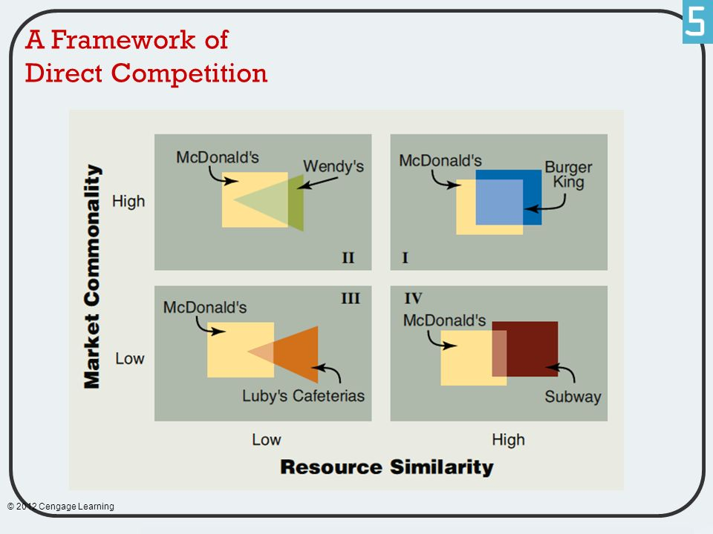

Slide 70
Organizational Strategy
Conclusion
  Strategic Moves of Direct Competition
    Attack – a competitive move designed to reduce a rival’s market share or profits
    Response – a competitive countermove, prompted by a rival’s attack, to defend or improve a company’s market share or profit.
Notes:
Final slide on Organizational Strategy
In general the more moves a company initiates against direct competitors, and the greater a companies tendency to respond when attacked, the better its performance. Can you think of some examples? Amazon. T- Mobile

Slide 71
Innovation and Change
Organizational innovation – the successful implementation of creative ideas in organizations.
A technology cycle begins with the birth of a new technology and ends when the technology reaches its limits and dies as it is replaced by a newer substantially better technology.
S –curve pattern of innovation – a pattern of innovation characterized by slow initial progress, then rapid progress, and then slow progress again as a technology matures and reaches its limits.
Notes:
Landline phones service is at the end of its technology cycle. Replaced by mobile.
Cable TV beginning a downward slope being replace by streaming
Discuss S-curve technology examples

Slide 72
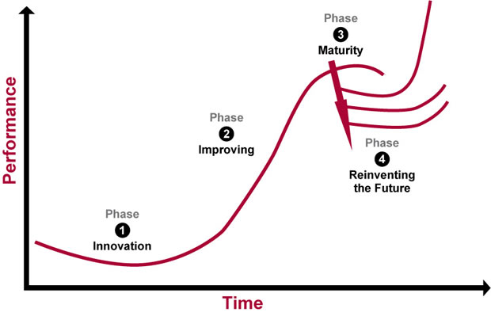
S –curve pattern of innovation

Slide 73
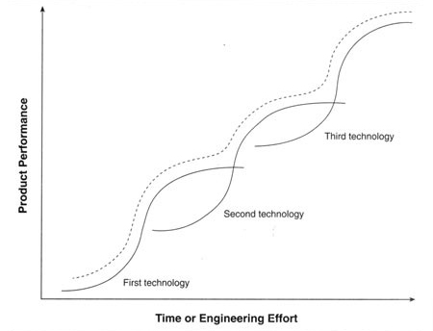
S –curve pattern of innovation

Slide 74
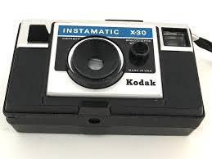
Innovation and Change
Technological innovation can enable a company to duplicate the benefits obtained from another company’s distinctive advantage. It can also turn another company’s competitive advantage into a competitive disadvantage.
Film camera (film dominated by Kodak) -- digital cameras (no film necessary) -- increasingly sophisticated digital camera -- smartphone camera (no extra cost to consumers, increasingly sophisticated features)
Notes:
Kodak is an example

Slide 75
Innovation and Change
Technology cycles occur whenever there are major advances in the knowledge, tools, and techniques of a field of discipline, whatever it may be.
Innovation Streams – patterns of innovation over time that can create sustainable competitive advantage.
The best way for a company to protect themselves from strategic threats of innovation is to create a stream on innovative ideas and products year after year.
Technological discontinuity – the phase of a innovation stream in which scientific advance or unique combination of existing technologies creates a significant breakthrough in performance or function.
Notes:
When you think of technology cycles don’t necessarily think of just high tech. Gutenberg's printing press, indoor plumbing, the advance of the internet all started new technology cycles.
Examples of companies that create innovative products year after year?

Slide 76

Innovation and Change
Discontinuous change – the phase of a technology cycle characterized by technological substitution and design competition.
  Technological substitution – the purchase of new technologies to replace older ones (i.e., smart phones vs. basic mobile phones)
  Design competition – competition between old and new technologies to establish a new technological standard or dominant design.
  Dominant design – a new technological design or process that becomes the accepted market standard.
Notes:
What are some examples of dominant design – flat panel TV’s; GUI operating systems; QWERTY keyboards; Blue Ray DVD. Dominant design can also emerge through international standards such as the International Telecommunications Unit (ITU) which was founded in 1865 to permit communications across borders. It has set initial standards for 5G wireless.

Slide 77
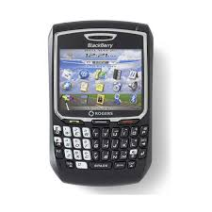

Innovation and Change
Technological lockout – the inability of a company to competitively sell its products because it relies on old technology or a non dominant design.
Incremental change – the phase of a technology cycle in which companies innovate by lowering costs and improving the functioning and performance of the dominant technological design.

Slide 78
Innovation and Change
Managing Innovation
  Creative work environments – workplace cultures in which workers perceive that new ideas are welcomed, valued, and enjoyed.
  Flow – a psychological state of effortlessness, in which you become completely absorbed in what you are doing, and time seems to pass quickly.
    Requires removing distractions
    Achieving a balance between skills and task challenge
Notes:
Next slide shows creative work environment chart.

Slide 79
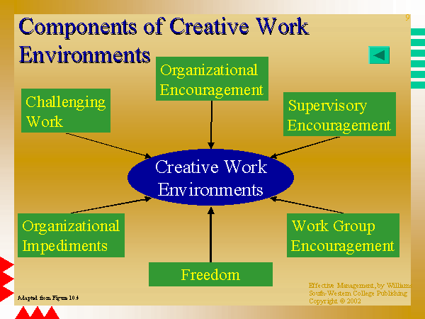

Slide 80
Innovation and Change
Experiential approach to innovation
Uses hands on experience to reduce uncertainty. Powerful leaders accelerate innovation (provide vision, discipline, and motivation)
  Design iteration – test a prototype of a new product, improve, build, test
  Product prototype – full scale working model - design, function, reliability
  Testing – the systematic comparison of different product designs or design iterations.
  Milestones – formal project review points used to assess progress and performance
  Multifunctional teams – work teams composed of people from different departments
Notes:
Powerful leaders accelerate innovation (provide vision, discipline, and motivation)
Example would be Google’s driverless cars

Slide 81
Innovation and Change
Compression approach – assumes that incremental innovation can be planned using a series of steps and that compressing those steps can speed innovation. (Goal includes lower cost)
Generational change - change based upon incremental improvements to dominant designs.

Slide 82
Innovation and Change
The risk of not changing / innovating
  Organizational decline – companies don’t anticipate, recognize, neutralize, or adapt to the internal or external pressures that threaten their survival .
  What are some examples of Organizational decline?
Notes:
Businesses operate in a constantly changing environment
Organizational decline - Computer City, Radio Shack, Blackberry, Borders Books, Music industry, GE

Slide 83
Innovation and Change
Managing Change
  Change forces – forces that produce differences in the form, quality, or condition of an organization over time
  Resistance forces - support the existing conditions in organizations
  Resistance to change – opposition to change resulting from self-interest, misunderstanding and distrust, and a general intolerance for change.
Notes:
It is important for leaders to establish a sense of urgency, and to establish a powerful coalition within the organization.

Slide 84
Innovation and Change
Managing Change (continued)
  Unfreezing – getting people affected by change to believe that change is needed.
  Change intervention – process used to get workers and managers to change their behavior and work practices
  Refreezing – supporting and reinforcing new changes so that they stick
  Coercion (use of formal power) should only be used when a crisis exists or when all other attempts have failed.

Slide 85
Innovation and Change
Change requires:
  A vision for change
  Communications
  Removing obstacles to change
  Systematically planning for and creating short-term wins
  Not declaring victory too soon
  Anchoring change in the corporate culture

Slide 86
Innovation and Change (Conclusion)
Change tools and techniques
  Results driven change – identify the needed result
  Workout – generate and act on specific solutions to specific business problems
  Organizational developments – planned change interventions designed to improve an organizations long term health and performance.
  Change agent – someone formally in charge of the change effort
Notes:
Last slide on innovation and change

Slide 87
Global Management
Global business is the buying and selling of goods and services by people from different countries.
Multinational corporations - a corporation that owns business in two or more countries.
  FedEx, InBev (Budweiser, Corona, Stella Artois, etc.), Royal Dutch Shell, McDonalds, Coca Cola
Direct foreign investment occurs when a company builds a new business or buys an existing business in a foreign country. Increasingly common way to do business
Notes:
Discuss example of multinational corporation's : FedEx; McDonalds, Coke, InBev,
Direct foreign investment example – InBev buying Anheuser Busch

Slide 88
Global Management
Trade barriers are Government imposed regulations that increase the cost and restrict the number of imported goods.
  Protectionism – a government’s use of trade barriers to shield domestic companies and their workers from foreign competition
  Tariffs – a direct tax on imported goods

Slide 89
Global Management
  Nontariff barriers
    Quotas – a limit on the number or volume of imported products.
    Voluntary export restraints – voluntarily imposed limits on the number or volume of products exported to a particular country.
    Government import standards – a standard ostensibly established to protect the health and safety of its citizens, but, in reality, is often used to restrict imports.
    Subsidies – government loans, grants, and tax deferments given to domestic companies to protect them from foreign competition.
    Customs classifications – a classification assigned to imported products by government officials that affects the size of the tariff and the imposition of import tariffs.

Slide 90
Global Management
Trade agreements
  General Agreement on Tariffs and Trade (GATT)
  World Trade Organization (WTO) – replaced GATT. Administers trade agreements and facilitates trade negotiations.
  Regional trading zones
  Maastricht Treaty of Europe (1992) – created the European Union
  North American Free Trade Agreement (NAFTA) – United States, Canada, Mexico. Eliminated most product tariffs between the three countries, and prevents (most) future tariffs. New NAFTA -USMCA
Notes:
Pending – Trans Pacific Partnership (TPP). Would lower barriers to trade for members. On January 23, 2017 President Trump signed a presidential memorandum to withdraw.

Slide 91
Global Management
Why do consumers care about free trade?
Why would a government impose trade restrictions?
Why do labor unions generally oppose free trade?
Notes:
Free trade = lower prices; increased consumer choice; increased purchasing power.
Trade restrictions = industry protectionism; jobs; national security.
Labor unions oppose – jobs; wage rates.

Slide 92
Global Management
Once a company decides it will go global, it must to decide how it will go global.
  Consistency vs. Adaptation
    Global consistency – when a multinational company has offices, manufacturing plants, and distribution facilities in different countries and runs them all using the same rules, guidelines, policies, and procedures.
    Local Adaption – modifying rules, guidelines, policies, and procedures to adapt to differences in foreign customers, governments, and regulatory agencies.
  Benefits of Adaptation vs. Benefits of Consistency

Slide 93
Global Management
Once a company decides it will go global, it must to decide how it will go global.
  Strategic Alliances – an agreement in which companies combine key resources, costs, risks, technology, and people
  Joint ventures – a strategic alliance in which two existing companies collaborate to form a third, independent company (Originally Verizon Wireless was a joint venture between Vodafone and Verizon)
  Wholly Owned affiliates
  Global New Ventures – new companies that are founded with an active global strategy and have sales, employees, and financing in different countries.

Slide 94
Global Management
Forms for global business
  Exporting – selling domestically produced products to customers in foreign countries.
  Cooperative contracts – comparison
    Licensing – Microsoft software; Television shows; some clothing brands
    Franchise – McDonald’s; KFC

Slide 95
Global Management
  Strategic alliance – an agreement in which companies combine key resources, costs, risks, technology, and people.
    Joint venture – a strategic alliance in which two or more companies collaborate to form a third, independent company.
  Wholly owned affiliates – foreign offices, facilities, and manufacturing plants that are 100% owned by a parent company.
  Global new ventures – companies that are founded with an active global strategy, and have sales, employees, and financing in different countries.

Slide 96
Global Management
Business climate considerations
  Growing markets; Purchasing power – the relative cost of a standard set of goods and services in different countries; Degree of global competition
  Choosing an office / manufacturing location
    Quantitative factors (taxes, exchange rates, labor costs, etc.)
    Qualitative factors (workforce quality, strategy)
  Political risk
    Political uncertainty – the risks from changes in political regimes that can result from war, revolution, death of political leaders, social unrest, or other influential events
    Policy uncertainty – the risk associated with changes in laws and government policies that directly affect the way foreign companies conduct business

Slide 97
Global Management
Awareness of Cultural Differences
  National culture – the set of shared values and beliefs that affect the perception, decisions, and behavior of the people from a particular country.
    Power distance
    Individualism
    Masculinity and femininity
    Uncertainty avoidance
    Short term / long term orientation
    Indulgence vs. restraint
Adopt to cultural differences – do not base the adaptions of management practices on outdated and incorrect assumptions about country’s culture.

Slide 98
Global Management
Conclusion
Employee considerations
  Expatriate – someone who lives and works outside his or her native country
  Language and cross cultural training
  Spouse, Family, dual career issues
With Globalism the importance of understanding the related management issues have take on a new importance for businesses of all sizes.
Notes:
Last slide on Global Management

Slide 99
Designing Adaptive Organizations
Organizational structure – the vertical and horizontal configuration of departments, authority, and jobs within a company.
  Who reports to whom?
  Who does what?
  Where does the work get done?
Organizational process – the collection of activities that transforms inputs into outputs that customers value.
  How do things get done?
  Departmentalization – subdividing work and workers into separate units responsible for particular business functions or areas of expertise.

Slide 100
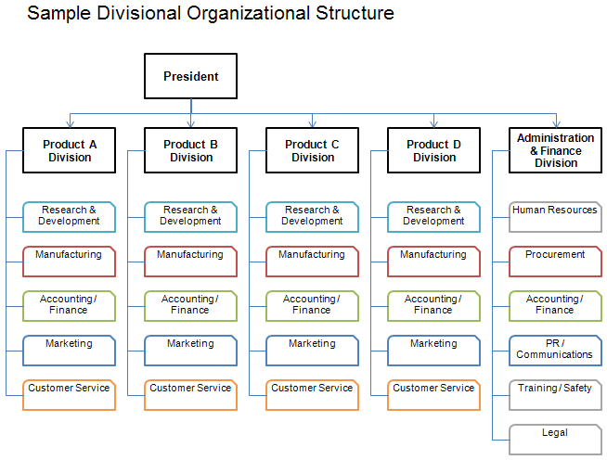
Designing Adaptive Organizations

Slide 101
Designing Adaptive Organizations
Functional departmentalization – organizing work and workers into separate units responsible for particular business functions or areas of expertise.
  Advantages
    Allows work to be done by highly qualified specialists
    Lowers cost by reducing duplication
    Less problematic for managers
  Disadvantages
    Cross-department coordination can be difficult (Marketing vs. Manufacturing)
    May lead to slower decision-making
    Managers and workers have narrower experience and expertise
Notes:
Example – production, accounting, sales, human resources, etc.

Slide 102
Designing Adaptive Organizations
Product departmentalization – organizing work and workers into separate units responsible for producing particular products or services.
  Advantages
    It allows managers to specialize in one area of expertise
    Makes it easier for top managers to assess performance
    Faster decision making because of fewer functional conflicts
  Disadvantages
    Duplication of functions (accounting, sales, HR, procurement etc.)
    Challenge of coordinating across product departments (could lead to non-standard policies and procedures)
Notes:
Example: United Technologies Corporation (UTC) – organized by Climate, Controls, Fire Safety, Food and Transportation; Pratt & Whitney - Jet engines; UTC Aerospace; and Otis elevators

Slide 103
Designing Adaptive Organizations
Customer departmentalization – organizing work and workers into separate units responsible for particular kinds of customers (consumer, enterprise).
  Advantages
    Focusses the organization on customer needs rather than on products or business functions.
    Allows companies to specialize and adapt to customer needs.
  Disadvantages
    Leads to duplication of resources
    Difficult to achieve coordination across different customer departments
    Could lead to decisions that help customers but hurt the business

Slide 104
Designing Adaptive Organizations
Geographic departmentalization – organizes work and workers into separate units responsible for doing business in particular geographic areas.
  Advantages
    Helps companies respond to demands of different markets
    Possible lowers cost by locating unique organizational resources closer to customers (e.g.. Reduced shipping costs)
  Disadvantages
    Duplication of resources
    Difficult to coordinate departments with geographic separation and limited individual personal contacts
Notes:
Example: AB InBev Company (exhibit 9.6)

Slide 105
Designing Adaptive Organizations
Matrix departmentalization – a hybrid organizational structure in which two or more forms of departmentalization, most often product and functional, are used together.
  Features
    Employees report to two bosses
    Leads to more cross functional interaction
    Requires significant coordination between managers
  Advantage - Allows efficient management of large complex tasks such as R&D through avoiding duplication
  Disadvantage - High level of coordination is required to manage to the complexity of the organization and the task

Slide 106
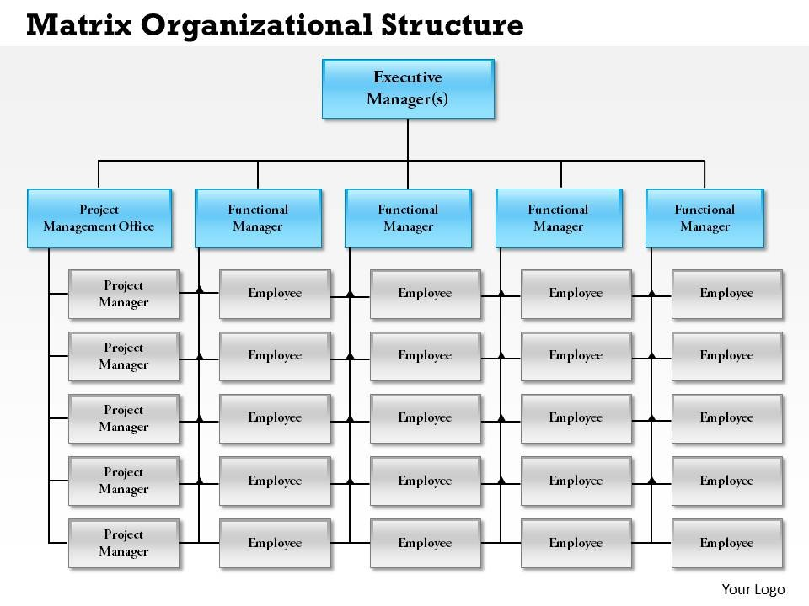
Designing Adaptive Organizations
Notes:
Example of a company: Proctor & Gamble

Slide 107
Designing Adaptive Organizations
Matrix (continued)
  Simple matrix – a form of matrix management departmentalization in which managers in different parts of the matrix negotiate conflicts and resources.
  Complex matrix – a form of matrix departmentalization in which managers in different parts of the matrix report of matrix managers, who help them sort out conflicts and problems.
Conclusion – There is no ideal organization design and that is why companies “reorganize”. In many cases it is important to adjust the organization to gain efficiencies and to respond to externalities. Executive spend a lot of time trying to get the right organizational structure.

Slide 108
Designing Adaptive Organizations
Organizational authority
  Authority – the right to give commands, take action, and make decisions to achieve organizational objectives.
  Chain of command – the vertical line of authority that clarifies who reports to whom throughout the organization
  Unity of command – principle that workers should report to just one boss. (differs from matrix organization)
Notes:
US Army (most military organizations) and Catholic Church are examples of chain of command

Slide 109
Designing Adaptive Organizations
Line vs. Staff authority
  Line authority – the right to command immediate subordinates in the chain of command.
  Staff authority – the right to advise, but not command, others who are not subordinates in the chain of command.
  Line function – an activity that contributes directly to creating or selling the company’s products.
  Staff function – an activity that does not contribute directly to creating or selling the company’s products but supports line activities (legal, HR, accounting).

Slide 110
Designing Adaptive Organizations
Delegation of authority – the assignment of direct authority and responsibility to a subordinate to complete tasks for which the manager is normally responsible.
  Advantages – Frees up the manager to do other important tasks. Provides training.
  Disadvantages – Difficult for many managers to give up full authority, leading to micromanagement. Delegated authority may not be commensurate with the delegated responsibility.

Slide 111
Designing Adaptive Organizations
Degree of Centralization - the location of authority in an organization.
  Centralization - most authority at the upper level of an organization
  Decentralization - significant amount of authority at lower levels
  Standardization – solving problems by consistently applying the same rules, procedures, and processes. (Dell Customer support)
Notes:
Next slide compares centralization and decentralization

Slide 112
BASIS FOR COMPARISON | CENTRALIZATION | DECENTRALIZATION
Definition | The retention of powers and authority with respect to planning and decisions, with the top management, is known as Centralization. | The dissemination of authority, responsibility and accountability to the various management levels, is known as Decentralization.
Communication Flow | Vertical | Open and Free
Decision Making | Slow | Comparatively faster
Advantage | Proper coordination and Leadership | Sharing of burden and responsibility
Power of decision making | Lies with the top management. | Multiple persons have the power of decision making.
Reasons | Inadequate control over the organization | Considerable control over the organization
Best suited for | Small sized organization | Large sized organization

Slide 113
Designing Adaptive Organizations
Job Redesign – modifying jobs to keep the benefits of specialized jobs while reducing their costs and disadvantages.
  Job enlargement – increasing the number of different tasks that a worker preforms within one particular job.
  Job enrichment – increasing the number of tasks in a particular job and giving workers the authority and control to make meaningful decisions about their work
Job Design – the number, kind, and variety of tasks that individual workers perform in doing their jobs.
Job Specialization – a job composed of a small part of a larger task or process.
Job Rotation – periodically moving workers from one specialized job to another to give them more variety and the opportunity to use different skills.

Slide 114
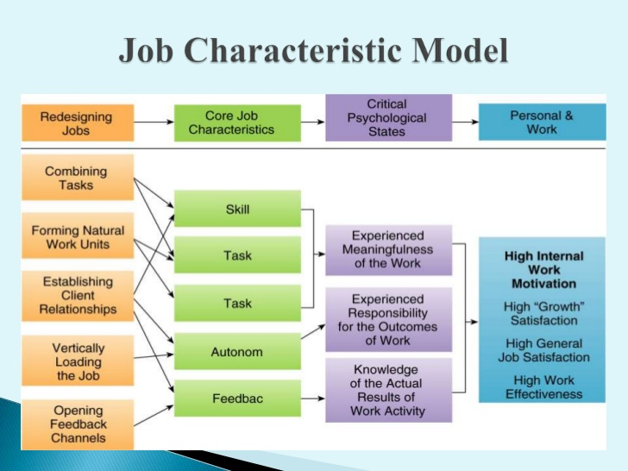
Designing Adaptive Organizations
Notes:
Exbibit 9.10 Page 198
Job Characteristics model = an approach to job redesign that seeks to formulate jobs in ways that motivate workers and lead to positive work outcomes.

Slide 115
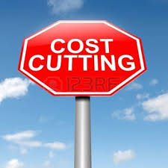
Designing Adaptive Organizations Intra- Organizational Processes
Reengineering – fundamental rethinking and radical redesign of business processes to achieve dramatic improvements in critical measures of performance, such as cost, quality, service, and speed.
  Task interdependence
    Pooled interdependence – each job or department independently contribute to the whole.
    Sequential interdependence – work completed in succession, with one group’s or job’s output becoming input for the next group or job.
    Reciprocal interdependence –work completed by different jobs or groups working together in a back and forth matter.
Notes:
Reengineering tries to reduce pooled and sequential interdependence while increasing reciprocal interdependence. It promises big rewards but is often viewed as just another cost cutting program that hurts morale and performance.

Slide 116
Designing Adaptive Organizations
Intra-Organizational processes (conclusion)
Empowerment – workers perceive their work to have impact and meaning and perceive themselves to be competent and capable of self determination.
Inter- organizational processes
  Modular Organizations – outsourcing non core activities
  Virtual Originations – companies sharing skills, costs, capabilities, etc., to collectively solve customer issues.
Conclusions – managers, especially top managers, expend a lot of resources trying to insure that they have the best designed organization.
Notes:
Concludes Designing Adaptive Organizations.

Slide 117
Managing Teams
Work teams – a small number of people with complementary skills who hold themselves accountable for pursuing a common purpose, achieving performance goals, and improving interdependent work processes.
  Advantages of teams: increase customer satisfaction; improve product and service quality; lead to increased job satisfaction through cross training.
  Disadvantages of teams: initial high turnover; social loafing (members not pulling their weight); groupthink; minority domination; reduced accountability
Notes:
We briefly talked about teams when we discussed Planning and Decision Making. (chapter 5)

Slide 118
Managing Teams
Use teams when:
  There is a clear engaging reason or purpose
  The job can’t be done unless people work together
  Rewards can be provided for teamwork and team performance
  Ample resources are available
Don’t use team when:
  There isn’t a clear engaging reason or purpose
  The job can be done by people working independently
  Rewards are provided for individual effort and performance
  The necessary resources are not available

Slide 119
Managing Teams
Traditional work group – a group composed of two or more people who work together to achieve a goal.
Employee involvement teams – teams that provide advice or make suggestions to management concerning specific issues
Semi-autonomous work groups – a group that has the authority to make decisions and solve problems related to the major task of producing a product or service.
Self-managing team – a team that manages and controls all of the major tasks of producing a product or service.
Self designing teams – has the characteristics of self-managed teams but also controls team design, work tasks, and team membership.

Slide 120
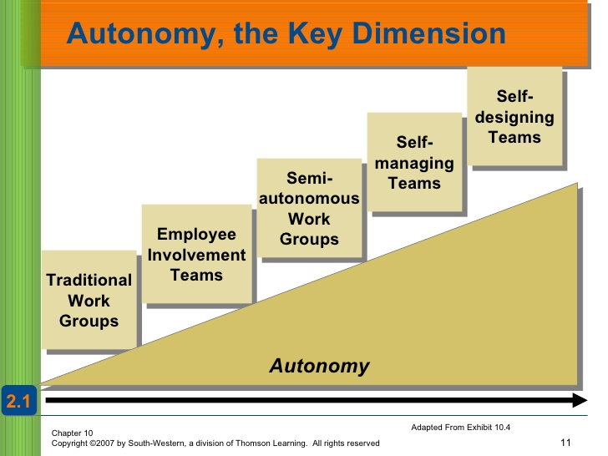

Slide 121
Managing Teams
Special kinds of teams
  Cross-functional team – team composed of employees from different functional areas of the organization. Often used with matrix and product organizational structures.
  Virtual team – a team composed of geographically and/ or organizationally dispersed coworkers who use telecommunications and information technologies to accomplish an organizational task. Are often temporary teams set up to accomplish a single task.
  Project team – a team created to complete specific, one time projects or tasks within a limited time. Often used with matrix organizations.

Slide 122
Managing Teams
Work Team Characteristics
  Team norms – informally agreed-on standards that regulate team behavior.
  Team cohesiveness – the extent to which team members are attracted to a team and motivated to remain in it.
  Team size – very small or very large teams may not perform as well as moderately sized teams.
  Team conflict – inevitable in most teams. Can be productive if it is cognitive conflict.

Slide 123
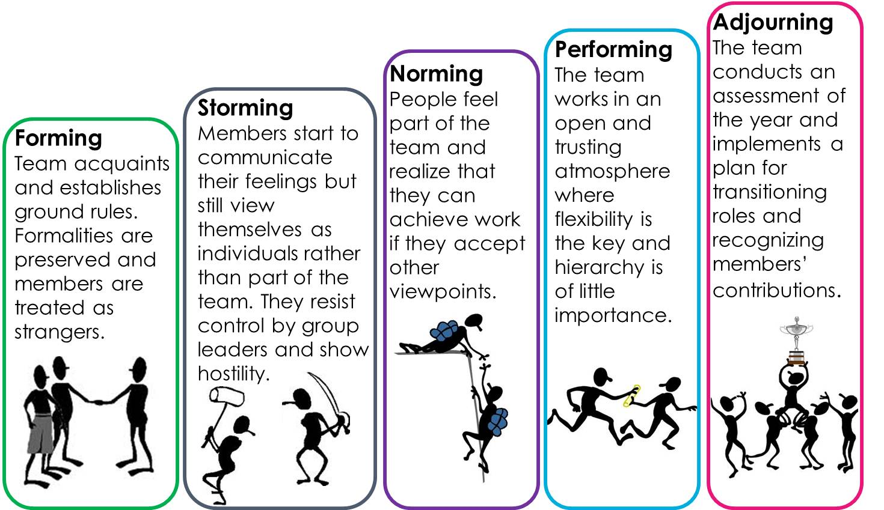
Managing Teams – Stages of Development
Notes:
Differs from Exhibit 10.4 (page 220) in that it say’s “adjourning” instead of de-norming, de-storming, and de-forming. I think this flow makes more sense.

Slide 124
Managing Teams
Enhancing Work Team Effectiveness
  Teams must have a high degree of autonomy.
  Teams must be empowered with control of resources.
  Teams need structural accommodation.
  Teams need bureaucratic immunity.
Specific team goals - clarifies team priorities by providing a clear focus and purpose.
Challenging team goals – when faced with difficult goals team members expect everyone to contribute.
Notes:
Structural accommodation means giving teams the ability to change organizational structures, policies and practices if doing so helps them meet their stretch goals.
Bureaucratic immunity means teams no longer have to go through bureaucratic multilevel reviews and sign offs before making changes.

Slide 125
Managing Teams
Selecting people for teamwork
  Individualism vs. collectivism – the degree to which a person believes that people should be self-sufficient and that loyalty to one’s self is more important than loyalty to team or company. (Individualist vs. Collectivist)
  Team level – the average level of ability, experience, personality, or any other factor on a team.
  Team diversity – the variances or differences in ability, experience, personality, or any other factor on a team.

Slide 126
Managing Teams
Team training – after selecting the right people you need to train them. Organizations often underestimate the amount of training.
  Interpersonal skills – skills, such as listening, communicating, questioning, and providing feedback, that enable people to have effective working relationships with others.
  Decision making and problem solving
  Conflict resolution
  Technical training
  Team leader training

Slide 127
Managing Teams
Compensation and Recognition
  Compensating teams is very difficult. Rewards must match the level of performance.
  Skill based pay – pay’s employees for learning additional skills or knowledge
  Gainsharing – companies share the financial value of performance gains, such as increased productivity, cost savings, or quality, with their workers
  Non-financial rewards – vacations, plaques, coffee mugs, certificates, praise. Employees value a sincere thank you.
Notes:
This is the last slide in managing teams

Slide 128
Managing Human Resource Systems
Human Resource Management (HMR) – the process of finding, developing, and keeping the right people to form a qualified workforce.
Federal Employment Laws
  Department of Labor (DOL)
  Equal Employment Opportunity Commission (EEOC)
  Occupational Safety and Health Administration (OSHA)
  Bona fide occupational qualification (BFOQ) – an exception in employment law that permits sex, age, religion, and the like to be used when making employment decisions, but only if they are “reasonably necessary to the normal operation of that particular business”. BFOQ’s are strictly monitored by the Equal employment Opportunities Commission.
Notes:
Video about 10 minutes

Slide 129
Managing Human Resource Systems
Adverse Impact and Employment Discrimination
  Disparate treatment – intentional discrimination that occurs when people are purposely not given the same hiring, promotion, or membership opportunities because of their race, color, sex, age, ethnic group, national origin, or religious beliefs.
  Adverse impact – unintentional discrimination that occurs when members of a particular race, sex, ethnic group are unintentionally harmed or disadvantaged because they are hired, promoted, or trained (or any other employment decision) at substantially lower rates than others.
  Four-fifths rule – a rule of thumb used by the courts and the EEOC to determine whether there is evidence of an adverse impact; a violation of this rule occurs when the impact ratio (calculated by dividing the decision ratio for a protected class by the decision ratio for a non protected group) is less than 80%, or four fifths.

Slide 130
Managing Human Resource Systems
Sexual Harassment – a form of discrimination in which unwelcome sexual advances, requests for sexual favors, or other verbal or physical conduct of a sexual nature occurs while performing one’s job.
  Quid pro quo sexual harassment
  Hostile work environment
  California sexual harassment training
  Sexual harassment in the news
Notes:
Video: 2 minutes

Slide 131
Managing Human Resource Systems
Recruiting – the process of developing a pool of qualified job applicants.
  Job analysis – a purposeful, systematic process for collecting information on the important work related aspects of a job.
  Job description – a written description of the basic tasks, duties, and responsibilities required of an employee holding a particular job.
  Job specification – a written summary of the qualifications needed to successfully perform a particular job.
Notes:
The above items help companies meet the legal requirement that their human resource decisions be job related.

Slide 132
Managing Human Resource Systems
Types of recruiting
  Internal – pool of qualified candidates from people who already work in the company.
  External – pool of qualified candidates from outside the company.
    Internet job sites including company career portals
    Job fairs / virtual job fairs
    Advertisements
    Employees referrals
    Recruiting – passive candidates, active candidates
Notes:
I got my first job in telecommunications by going to my university employment office.
Some companies such as Walmart, Frontier make an extra effort to recruit veterans.
Each form of recruiting has advantages and disadvantages including costs, targeted pool of applicants, etc.

Slide 133
Managing Human Resource Systems
Selection – the process of gathering information about job applicants to decide who should be offered a job.
  Validation – the process of determining how well a selection test or procedure predicts future job performance.
  Application forms and résumés– first device used as part of the selection process. Application forms are subject to employment laws.
  Managers should verify information collects via résumés and application forms: Employment references; Background checks
  Selection tests – gives employers a chance to know who will likely do well in a job and who won’t. (Types of tests are covered in text section 11-3c)
Notes:
Discuss my own experience with receiving exaggerated résumés.

Slide 134
Managing Human Resource Systems
Selection (continued)
  Interviews – a selection tool in which company representatives ask job applicants job-related questions to determine whether they are qualified for the job.
    Unstructured interviews – interview in which interviewers are free to ask the applicants anything that they want.
    Structured interviews – interviews in which all applicants are asked the same set of standardized questions, usually including situational, behavioral, background, and job-knowledge questions.
    Semi-structured interviews – Consists of mostly structured questions, but some time is set aside for unstructured interviewing. Allows interviewers to probe answers to structured questions.
Notes:
Relay personal experience with structured and non structured interviews.

Slide 135
Managing Human Resource Systems
Training – provides meaningful benefits for most companies if it is done well.
Needs assessment – the process of identifying and prioritizing the learning needs of employees.
Training methods – videos, lectures, planned readings, coaching, mentoring, group discussions, on the job training, computer based learning, etc.
Evaluating training – reactions, learning, behavior, results.

Slide 136
Managing Human Resource Systems
Performance appraisals – the process of assessing how well employees are doing in their job.
  Objective performance measures – measures that are easily and directly counted and quantified (sales, units produced, billable hours, etc..)
  Subjective performance measures – measures that require someone to judge or assess a workers performance
  Behavior Observation Scales (BOS) – rating scales that indicate the frequency with which workers perform specific behaviors that are representative of the job dimensions critical to successful job performance.
  Rater training ; Performance appraisal feedback

Slide 137
Managing Human Resource Systems
Compensation and Employee Separation
  Compensation – the financial and non financial rewards that organizations give employees in exchange for their work.
  Employee separation – the voluntary or involuntary loss of an employee
  Job evaluation – a process that determines the worth of each job in a company by evaluating the market value of the knowledge, skills, and requirements needed to perform it.

Slide 138
Managing Human Resource Systems
Compensation Decisions
  Piecework
  Commission
  Profit sharing
  Employee stock ownership plan – awards employees shares of company stock in addition to their regular pay
  Stock option – gives employees the rights to purchase shares of company stock at a set price, even if the value of the stock increases above that price. Stock options have increasing been replaced by restricted stock unit (RSU) grants or Performance Stock Units (PSU).

Slide 139
Managing Human Resource Systems
Conclusion
Terminating employees
  Should not be the first option; Should only be done for a good reason
  Wrongful discharge – according to Williams employees win 68% of wrongful discharge cases at an average award of over $500,000.
  Downsizing – the planned elimination of jobs in a company.
  Retirement
Employees turnover – loss of employees who voluntarily choose the leave a company
  Functional turnover
  Dysfunctional turnover
Notes:
Employee turnover should be carefully analyzed to determine whether good or poor employees are choosing to leave the company.
This is the last slide on HRM systems

Slide 140
Managing Individuals and a Diverse Workforce
Diversity – a variety of demographic, cultural, and personal differences among an organization's employees and customers.
Diversity is not affirmative action – can lead to cost savings, attracting and retaining talent, and driving business growth.
Affirmative action is purposeful steps taken by an organization to create employment opportunities for minorities and women.

Slide 141
Managing Individuals and a Diverse Workforce
Surface level diversity – observable, easy to measure
  Age
  Sex
  Race/Ethnicity
  Mental of Physical Disability
Notes:
Treating people differently because of any of the above factors is discrimination.

Slide 142
Managing Individuals and a Diverse Workforce
Deep-Level Diversity – impressions based upon behavior and psychological characteristics
  Disposition –the tendency to respond to situations in a predetermined manner.
  Personality – the relatively stable set of behaviors, attitudes, and emotions displayed over time that makes people different from each other.
  Personality Dimensions - Extraversion; Emotional stability; Agreeableness; Conscientiousness; Openness to experience
Notes:
Se page 266 – 267 for personality dimensions.

Slide 143
Managing Individuals and a Diverse Workforce
Managing Diversity
  Diversity Principles – General approaches or strategies for managing diversity.
    Treat group differences as important but not special
    Find common ground
    Tailor opportunities to individuals not groups.
    Maintain high standards (fair to all)
    Solicit negative as well as positive feedback.
    Set high but realistic goals

Slide 144

Managing Individuals and a Diverse Workforce
  Diversity Training and Practices
    Skills-based diversity training
    Awareness training – raise employees awareness of diversity issues and to challenge the underlying assumptions or stereotypes they may have about others.
    Diversity audits
    Diversity pairing
Notes:
Last slide in Managing Individuals and a Diverse Workforce
Diversity audits are as the name implies are formal assessments of diversity related policy and procedures
Diversity pairings - a mentoring program in which people of different backgrounds are paired together to get to know each other and change stereotypical beliefs and attitudes.

Slide 145
Motivation
Motivation is the set of forces that initiates, directs, and makes people persist in their efforts to accomplish a goal.
Job performance=Motivation x Ability x Situational Constraints
Notes:
Model on next slide

Slide 146
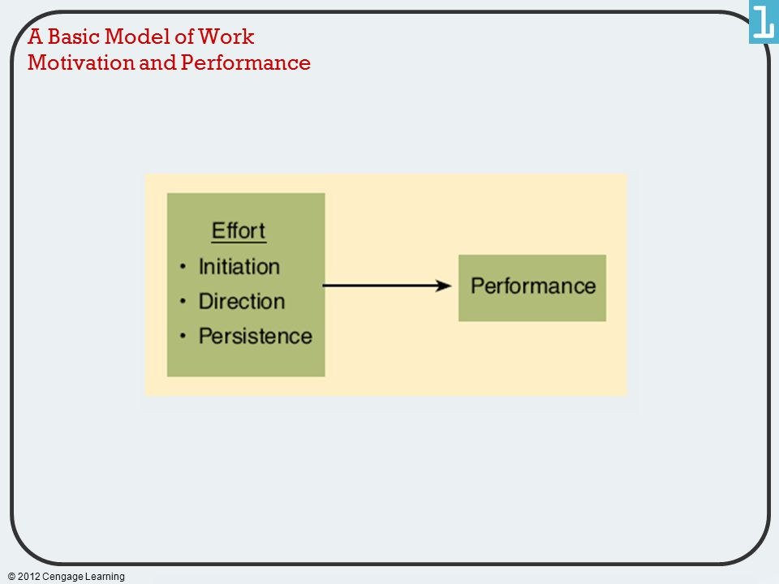

Slide 147
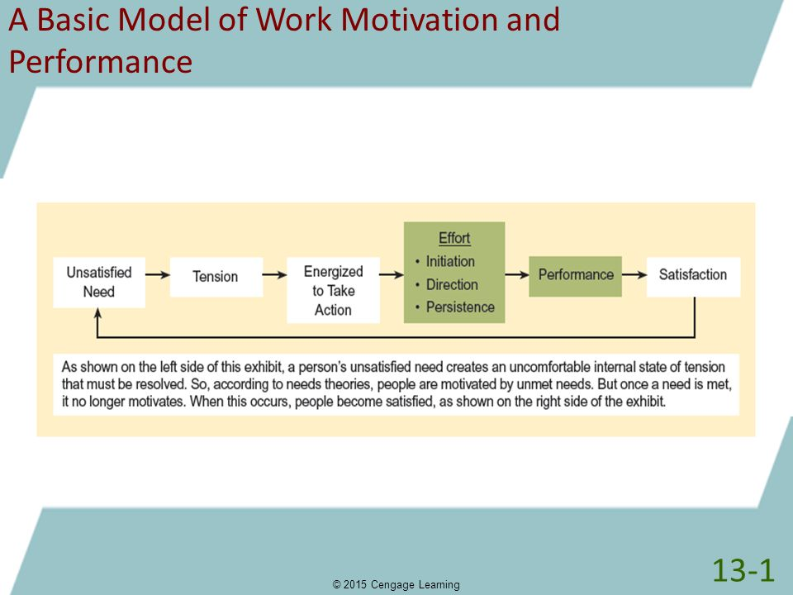

Slide 148
Motivation
Needs – the physical or psychological requirements that must be met to insure survival and well being.
  People are motivated by unmet needs
  Maslow’s hierarchy of needs (next slide)

Slide 149
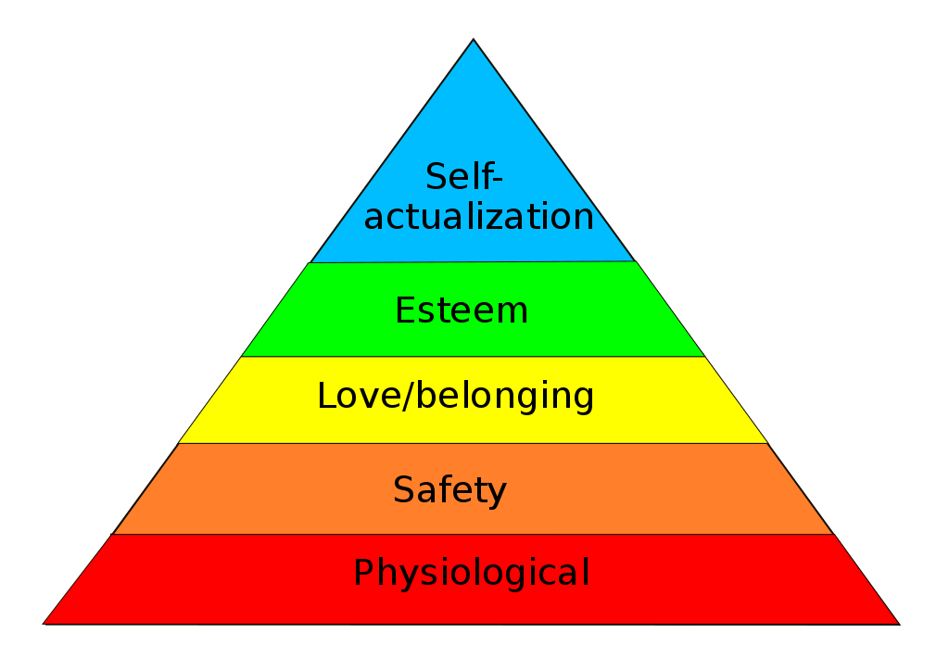

Slide 150
Motivation
Rewards
  Extrinsic rewards – a reward that is tangible, visible to others, and given to employees contingent on the performance of specific tasks or behaviors.
  Intrinsic rewards – a natural reward associated with performance of specific tasks or behaviors. For example, a sense of accomplishment or achievement.
  Both types of rewards are important to workers.
Notes:
Discuss project Guava.

Slide 151
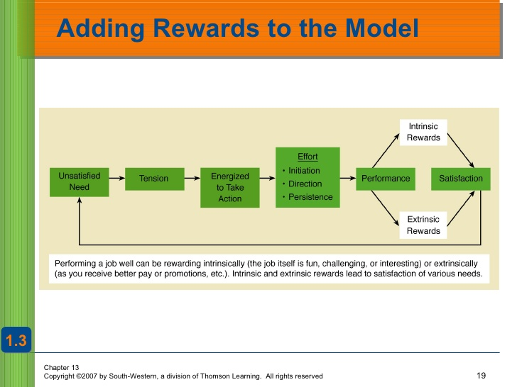
Motivation

Slide 152
Motivation
Motivating -- the basics
  Find out peoples needs
  Satisfy lower order needs first
  Expect peoples needs to change
  As lower orders needs are satisfied, create opportunities for employees to satisfy higher-order needs. This can be done by creating opportunities for employees to experience intrinsic rewards by providing challenging work, encouraging employees to take greater responsibility for their work, and giving the employees freedom to purse other task and projects that they find interesting.

Slide 153
Motivation
Equity Theory – people will be motivated when they perceive they are being treated fairly.
  Inputs (contributions employees make to the organization)
  Outputs (rewards employees receive for their contribution to the organization)
  Referents (others with whom people compare themselves)
  Outcome/ input ratio (employees perception of rewards received vs. contributions)
  Under-rewarded (inequity)
  Overrewarded (inequity)

Slide 154
Motivation
Equity Theory (continued)
Perceived Inequity
  Affects satisfaction
  Frustration, dissatisfaction, guilt

Slide 155
Motivation
Equity Theory (continued)
  Motivating with equity theory
    Correcting major inequities
    Reduce employees inputs (ask employees to do less)
    Fair decision making processes
      Distributive justice – the perceived degree to which rewards are fairly distributed or allocated
      Procedural justice – the perceived fairness of the process used to make a reward allocation decision

Slide 156
Motivation
Expectancy Theory – people will be motivated to the extent which they believe that their efforts will lead to good performance, that good performance will be rewarded, and that they will be offered attractive rewards.

Slide 157
Motivation
Components of expectancy theory
  Motivation = Valence x Expectancy x Instrumentality
  Valence – the attractiveness or desirability of a reward or outcome
  Expectancy – the perceived relationship between efforts and performance
  Instrumentality - the perceived relationship between performance and rewards
Notes:
Managers can and should systematically find out what employees want out of their jobs. (ask employees, survey employee)
Managers can take steps to link rewards with performance in a way that is clear and understandable to employees.
Empower employees to make decisions. This motivates only if employees believe their efforts will lead to good performance).

Slide 158
Motivation
Reinforcement Theory
  Reinforcement – the process of changing behavior by changing the consequences that follow behavior
    Positive – good behavior equals desirable consequence
    Negative – withholding an unpleasant consequence when a specific behavior is performed
    Punishment – reinforcement that weakens behavior by following behaviors with undesirable consequences.
  Reinforcement schedules – Continuous, Intermittent, Fixed interval, Fixed ratio, Variable ratio
  Motivating with reinforcement theory – identify, measure, analyze, intervene, evaluate
Notes:
See text page 290 for definitions of reinforcement schedules.

Slide 159
Motivation
Conclusion
Goal-setting theory – people will be motivated to the extent to which they accept specific, challenging goals and receive feedback that indicates their progress towards achievement.
  Goal – a target, objective, or result that someone tries to accomplish.
  Goal specificity – the extent that goals are detailed, exact, and unambiguous
  Performance feedback – information about the quality or quantity of past performance that indicates whether progress is being made towards accomplishment of a goal
Notes:
Motivation is the set of forces that initiates, directs and makes people persist in their efforts to accomplish a goal. If you are having difficulty determining why workers are not motivated remember that what motivates people is likely to be different for each person!
Last slide in Motivation.

Slide 160
Leadership
Leadership – the process of influencing other to achieve group or organizational goals.
Leadership traits (7 qualities)
  Traits – relatively stable characteristics, such as abilities, phycological motives, or consistent patterns of behavior.
  Trait Theory – a leadership theory that holds that effective leaders possess a similar set of traits or characteristics. The idea that successful people are not like other people.
  Traits include - drive, desire to lead, self-confidence, emotional stability, cognitive ability, knowledge of the business
Notes:
Leadership traits video 7:20

Slide 161
Leadership
Leadership Behaviors
  Initiating structure – the degree to which leaders structure the roles of followers by setting goals, giving direction, setting deadlines, and assigning tasks.
  Consideration – the extent to which a leader is friendly, approachable, and supportive and shows concern for employees.
  Researchers have found that the most effective leaders were strong on both initiating structure and considerate leader behavior. However, there isn’t a “best leadership style”.
Notes:
Discuss personal experience with leading and being led.

Slide 162
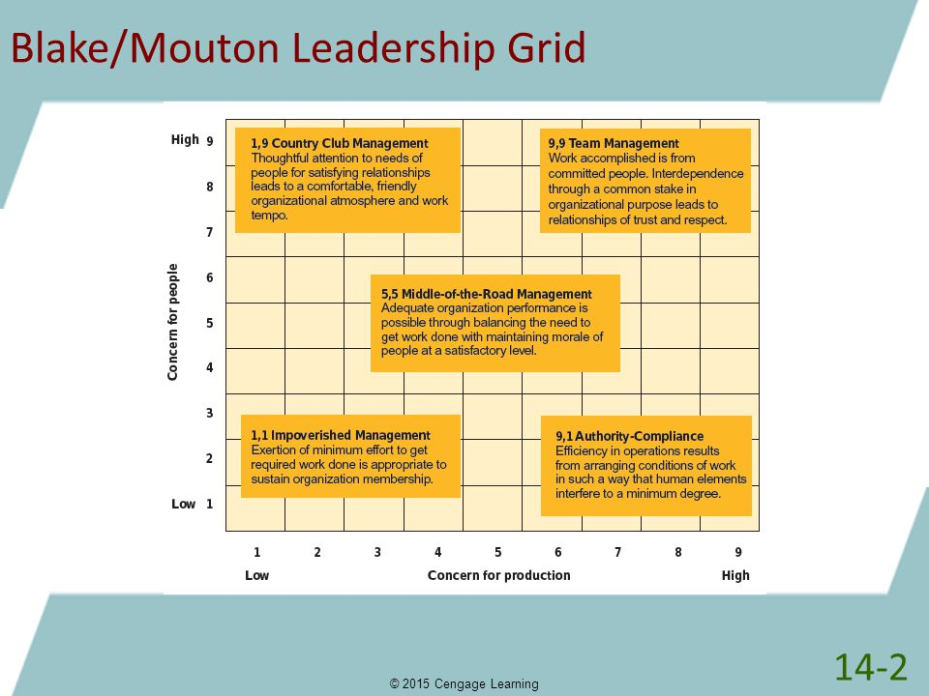
Notes:
Blake Moulton consider 9.9 as the best style – Exhibit 14.1 (page 302)
Team Management is viewed as the ideal

Slide 163
Leadership
Putting Leaders in the right situation
Leadership style – the way a leader behaves towards followers.
Contingency theory (Fiedler) – a leadership theory states that to maximize work group performance, leaders must be matched to the situation that best fits their leadership style.
  Leaders are effective when the work groups they lead perform well
  Leaders are more effective when their leadership style matches the situation
  Favorableness depends upon the degree to which the situation permits the leader to influence the behavior of group members.
Notes:
Video 3:13
It is hard to change leaders styles. It is better to put a leader into the right situation for their style to get the best performance.
Leaders must be allowed to lead

Slide 164
Leadership
Situational Favorableness – the degree to which a situation either permits or denies a leader the chance to influence the behavior of group members.
  Leaders member relations – the degree to which followers respect, trust, and like their leader.
  Task structure – the degree to which the requirements of a subordinate’s tasks are clearly specified.
  Position power – the degree to which the leaders are able to hire, fire, reward, and punish workers.

Slide 165
Leadership
Adapting leader behavior
  Path-goal theory – a leadership theory that leaders can increase subordinate satisfaction and performance by clarifying and clearing the paths to goals and by increasing the number and kinds of rewards available for goal attainment.

Slide 166
Leadership
Leadership styles
  Directive leadership – a leadership style in which the leader lets employees know precisely what is expected of them, gives them specific guidelines for performing tasks, schedules work, sets standards of performance, and makes sure that people follow standard rules and regulations.
  Supportive leadership – style in which the leader is friendly and approachable to employees, shows concern for employees and their welfare, treats them as equals, and creates a friendly climate.

Slide 167
Leadership
Leadership styles (continued)
  Participative leadership – a leadership style in which the leader consults employees for their suggestions and input before making decisions.
  Achievement oriented leadership – a leadership style in which the leader sets challenging goals, has high expectations of employees, and displays confidence that employees will assume responsibility and put forth extraordinary effort.

Slide 168
Leadership
Visionary leadership
  Strategic leadership – the ability to anticipate, envision, maintain flexibility, think strategically, and work with others to initiate changes that will create a positive future for an organization.
  Visionary leadership – leaders that create a positive image of the future that motivates organizational members and provides direction for future planning and goal setting.

Slide 169
Leadership
Charismatic leadership – the behavioral tendencies and personal characteristics of leaders that create an exceptionally strong relationship between them and their followers.
  Articulate a clear vision for the future that is based on strongly held values and morals
  Model those values by acting in a way consistent with the vision
  Communicate high performance expectations to followers
  Display confidence in followers’ abilities to achieve the vision

Slide 170
Leadership
Ethical charismatics – charismatic leaders who provide developmental opportunities for followers, are open to positive and negative feedback, recognize other’s contributions, share information, and have moral standards that emphasize the larger interests of the group, organization, or society.
Unethical charismatics – charismatic leaders who control and manipulate followers, do what is best for themselves instead of their organizations, want to hear only positive feedback, share only information that is beneficial to themselves, and have moral standards that put their interests before everyone else’s.

Slide 171
Leadership
Transformational leadership – leadership that generates awareness and acceptance of a group’s purpose and mission and gets employees to see beyond their own needs and self-interests for the good of the group.
  They transform organizations by getting their followers to accomplish more than they intended and even more that they thought possible.
    Idealized influence – serve as a role model
    Inspirational motivation
    Intellectual stimulation
    Individualized consideration –discussing and emphasizing with the needs of individual employees
Notes:
Video 3:30

Slide 172
Leadership
Conclusion
Transactional leadership – leadership based upon an exchange process in which followers are rewarded for good performance and punished for poor performance.
Transformational leaders achieve better overall financial results than transactional leaders.
Successful leadership
Charisma matters
Notes:
Last leadership slide
Mary Barra 9:09
Charisma matters 16:03

Slide 173
Managing Communication
Introduction Exercise
Identify a good communicator. This person could be a person that you know, a public figure, or a historical figure.
What specifically makes that person a good communicator?
Examples of good communicators

Slide 174
Managing Communication
Communication – the process of transmitting information from one person to another.
  A very significant part of effective communication is perception.
  Ways to improve communications
Perception – the process by which individuals attend to, organize, interpret, and retain information from their environment.
Perceptual filters – the personality, psychology, or experience based differences that influence people to ignore or pay attention to particular stimuli.
Notes:
Managers spend a lot of time communicating but little time planning their communication.

Slide 175
Managing Communication
Perceptual filters:
  Attention – the process of noting or becoming aware of particular stimuli.
  Organization – the process of incorporating new information onto your existing knowledge.
  Interpretation – the process of attaching meaning to new knowledge.
  Retention – the process of remembering interpreted information. Retention affects what we recall and commit to memory.

Slide 176
Managing Communication
Perception problems
Selective perception – the tendency to notice and accept objects and information consistent with our values, beliefs, and expectations, while ignoring or screening inconsistent information.
Closure – the tendency to fill in gaps of missing information by assuming that what we don’t know is consistent with what we already know.
Notes:
Discuss the positives and negatives of closure

Slide 177
Managing Communication
Perceptions of Others
  Attribution theory – the theory that we all have a basic need to understand and explain the causes of other peoples behavior.
  Defensive bias – the tendency for people to perceive themselves as personally and situationally similar to someone who is having difficulty or trouble.
  Fundamental attribution error – the tendency to ignore external causes of behavior and to attribute other people’s actions to internal causes.
Notes:
Discuss examples of each error or bias.

Slide 178
Managing Communication
Self serving bias – the tendency to overestimate our value by attributing success to ourselves (internal causes) and attributing failures to other causes or the environment (external causes).
  People have a need to maintain a positive self-image.
  People can become defensive when managerial communication threatens their positive self-image.

Slide 179
Managing Communication
Kinds of Communication - Summary
  The Communications process
  Formal Communications channels
  Coaching and Counseling (one-on-one communication)
  Non-verbal communication
Notes:
These are detailed on the following slides!

Slide 180
Managing Communication
The Communications Process
  Encoding – putting a message into a written, verbal, or symbolic form that can be recognized and understood by the receiver.
  Decoding – the process by the receiver translates the written, verbal, or symbolic form of a message into an understood message.
  Feedback to sender – a return message to the sender that indicates the receiver’s understanding of the message
  Noise- anything that interferes with the transmission of the intended message.
  Jargon – vocabulary particular to a profession or group that interferes with communication in the workplace. (downsizing, drilling down, restructuring)

Slide 181
Managing Communication
Formal Communications Channel – the system of official channels that carry organizationally approved messages and information.
  Downward communications – flows from higher to lower levels in an organization
  Upward communications – flows from lower to higher levels in an organization
  Horizontal communications – flows among managers and workers who are the same level in an organization

Slide 182
Managing Communication
Informal Communication Channels (grapevine)
  The transmission of messages from employee to employee outside of formal communications channels
  Studies show that grapevines are highly accurate sources of information
    Because the information is “juicy” and timely and interesting it spreads rapidly
    Typically spread by face to face conversations which can reduce misunderstandings and increase accuracy
    Most information in a company moves through the grapevine rather than through formal communications channels.
  Managers should embrace the grapevine and keep employees informed. Also, it can be a valuable source of information to managers.
Notes:
Managers, however, must be aware of public disclose requirements which may limit their ability to provide feedback on grapevine rumors.

Slide 183
Managing Communication
What is the most effective way to communicate the following?
Why?
  Specific work / task assignments?
  Dress code, code of conduct?
  Important life event such as engagement, divorce, pregnancy?
  Employee termination?
  Quarterly earnings?
  Customer complaints?
  Employee training?

Slide 184
Managing Communication
Choosing the Right Communication Medium – effectiveness vs. efficiency
  Oral communication – face to face interactions, group meetings, phone calls
  Written communication - includes letters, emails, memos
  “Chat” / online discussion groups
Listening
  Hearing
  Listening – making a conscious effort to hear
  Active listening – giving the speaker non judgmental feedback that shows that you heard what was said
  Empathetic listening – understanding the speakers perspective and personal frame of reference and giving feedback that conveys that understanding.
Notes:
Video 10 minutes
Communication medium is the method used to deliver an oral or written message.
Oral communications are best suited for complex, ambiguous, or emotional messages.

Slide 185
Managing Communication
Giving Feedback
  Destructive feedback – feedback that disapproves without any intention of being helpful and almost always causes a negative or defensive reaction in the recipient
  Constructive feedback – feedback intended to be helpful, corrective, and/or encouraging
    Should be immediate and focused on specific behaviors
    Specific feedback focuses on particular acts or incidents
    Problem oriented feedback focuses on the problem or incident associated with poor performance
Notes:
Most managers are not good at giving feedback.

Slide 186
Managing Communication
One-on-one Communication
  Coaching – communication with someone for the direct purpose of improving the person’s on the job performance or behavior
  Counseling - communication with someone about non job related issues that may be affecting or interfering with the person’s performance (refer personal issues to Employee Assistance Programs)
Notes:
Nonverbal communications is very informative. Therefore, managers need to learn how to monitor and control their nonverbal behaviors.

Slide 187
Managing Communication
Nonverbal Communication – any communication that does not involve words.
  93% of information is transmitted nonverbally.
    55% comes from body language
    38% comes from the tone and pitch of the voice
  Kinesics – movements of the body and face
  Paralanguage – the pitch, rate, tone, volume, and speaking pattern (that is, use of silences, pauses, or hesitations) of ones voice.

Slide 188
Managing Communication
Organization Wide Communication
  Online discussion forums
  Televised / webcast speeches and meetings
  Broadcast voice mail

Slide 189
Managing Communication
Crisis Management
Managing communications in a crisis.
Name some organizations that have had to deal with a crisis. How well have they done? (President Trump, Facebook, Boeing, PG&E, Wells Fargo)
  10 steps of crisis management
  Consult your legal counsel
  Consider ethical principles

Slide 190
Managing Communication
Conclusion
Improving reception
  Organizational silence – when employees withhold information about organizational problems or issues
  Company hotlines
  Survey feedback
  Blog
  Town hall meetings
Communicate, Communicate, Communicate
8 secrets of great communicators
Notes:
Final slide on Managing communications

Slide 191
Control
Control - a regulatory process of establishing standards to achieve organizational goals, comparing actual performance against the standards, and taking corrective action when necessary.
Standards – a basis of comparison for measuring the extent to which various kinds of organizational performance are satisfactory or unsatisfactory.
Notes:
Overview Video 3:00
Effective control Video 4:30 minutes

Slide 192
Control
  Benchmarking – the process of identifying outstanding practices, processes, and standards in other companies and adapting them to your company.
    Cycle time
    Price
    Quality
    What companies should be the benchmark
  Effective control systems
Notes:
Video 4:30 minutes

Slide 193
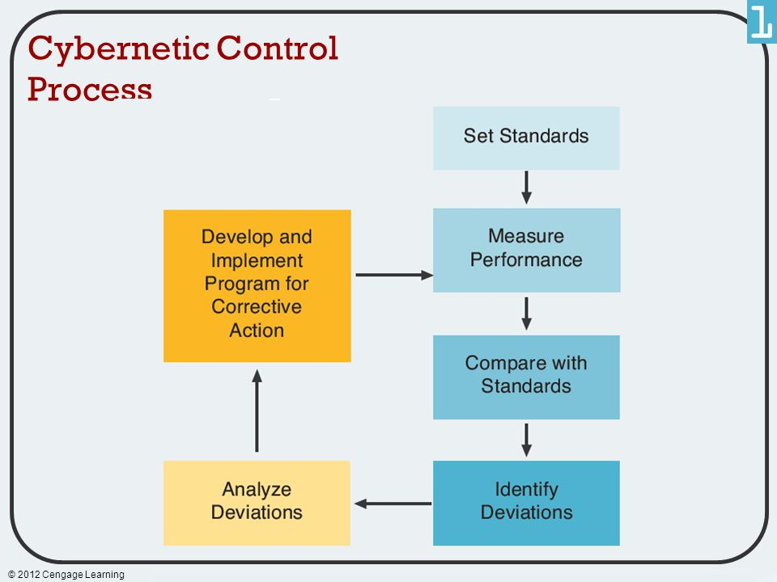
Notes:
Cybernetic – the process of steering or keeping on course.

Slide 194
Control
Control Methods
Feedback control – gathering information about performance after deficiencies occur
Concurrent control – gathering information about performance deficiencies as they occur
Feedforward control – monitoring performance inputs rather than outputs to prevent or minimize performance deficiencies before they occur

Slide 195
Control
Control loss – the situation in which behavior and work procedures do not conform to standards.
Regulation (control) costs – the costs associated with implementing or maintaining control.
Cybernetic feasibility – the extent to which it is possible to implement each step in the control process. (If one or more steps cannot be implemented then maintain effective control may be difficult or impossible).
Notes:
Regulation costs – does the cost if control exceed the benefits?

Slide 196
Control
Control Methods
  Bureaucratic control – top down control, in which managers try to influence behavior by rewarding or punishing employees for compliance or non-compliance with rules, policies, and procedures
  Objective control – the use of observable measures or workers behaviors or outputs to assess performance and influence behavior
    Behavior control –regulation of behavior and actions that workers perform
    Output control – regulation of results

Slide 197
Control
  Normative control – the regulation of workers’ behaviors and actions through widely shared organizational values and beliefs.
  Concertive Control – the regulation of worker’s behavior and decisions through work group values and beliefs.
  Self-control (self-management) – managers and workers control their own behavior by setting their own goals, monitoring their own progress, and rewarding themselves for goal achievement.
Notes:
Normative controls –1) be very selective in hiring; 2) managers should learn what to do by observing experienced employees and listening to the stories they tell about the company.
Concertive controls are shaped and negotiated by work groups. Recall Managing Teams.

Slide 198
Control
What to Control?
Balanced Scorecard – Measurement of organizational performance in four equally important areas:
  Finances
  Customers
  Internal operations
  Innovation and learning
Sub optimization – Performance improvement in one part of an organization but only at the expense of decreased performance in another part.
Notes:
A final element to control is to determine what to control. If you control for one thing you will likely miss critical success factors. However, if you control too many things managers and employees can become confused about what is really important.

Slide 199
Control
Finance Control
  Cash flow analysis
  Balance sheet
  Income statements
  Financial ratios
  Budgets
  Economic value added (EVA) – the amount by which company profits (revenues minus expenses minus taxes) exceed the cost of capital in a given year.
Notes:
Discuss EVA (“you borrow money at a certain rate and invest it at a higher rate and pocket the difference”).

Slide 200
Control
Customers
  Customer defections – a performance assessment in which companies identify which customers are leaving and measure the rate at which they are leaving.
  Customer survey – Good but may be misleading by themselves.
  Net Promoter score (NPS)
Notes:
NPS discussed more on the next slide.

Slide 201
Control
Net Promoter Score
The Net Promoter Score is an index ranging from -100 to 100 that measures the willingness of customers to recommend a company’s products or services to others. It is used as a proxy for gauging the customer’s overall satisfaction with a company’s product or service and the customer’s loyalty to the brand.
Customers are surveyed on one single question. They are asked to rate on an 11-point scale the likelihood of recommending the company or brand to a friend or colleague.
“On a scale of 0 to 10, how likely are you to recommend this company’s product or service to a friend or a colleague?”
Based on their rating, customers are then classified in 3 categories: detractors, passives and promoters.

Slide 202
Control
Internal Perspective – the processes, decisions, and actions that managers and workers make within the organization.
  Quality – excellence, value and conformance to expectations. Quality is also discussed in Chapter 18 – a product or service free from deficiencies, or the characteristics of a product or service that satisfy customer needs.
  Value – customer perception that the product quality is excellent for the price offered.
  The way that a company defines quality affects the methods and measures that employees use to control quality.
Notes:
Discuss quality experiences: Costco; Nordstrom's; Southwest Airline

Slide 203
Control
Innovation and Learning Perspective
Can an organization continue to improve and create value?
  Sustainability is an example of an area in which many companies are striving for continuous improvement.
    1. Waste prevention & reduction – prevent waste and pollution before they occur
    2. Recycle & reuse
    3. Waste treatment
    4. Waste disposal
Notes:
This is the last slide on Control.
Amazon

Slide 204
Managing Information
Consumer Data
Social
Mobile
Cloud
AI
IOT
Video
Collecting information – capture, manage, store, share, preserve, and deliver information.
Notes:
What businesses / organizations use consumer data? IRS, CSULA, Amazon, Google, Facebook, Target, Netflix, Political consultants
Your mobile carrier, Hospitals and health care, most financial institutions, Insurance companies, all employers.

Slide 205
Protecting Information
Data breaches (source CNN, September 4, 2017)
  Yahoo – 2013, 2014; 500 million accounts and subsequently they disclosed a second breach of over 1 billion accounts
  Equifax – 2017; 143 million
  Myspace – 360 million accounts by a Russian hacker.
  LinkedIn – 2012 but not made public until 2016. 100 million users
  Heartland – 2008 exposed 130 million accounts (credit card processor)
  Target – 2013; impacted 40 million customers
Congressional Hearings – 2017; Facebook 2018
Notes:
Bottom line is that protecting data is important and costly.
Yahoo video : 3:29 minutes
Facebook video 6:16 minutes

Slide 206
Managing Information
Information has strategic importance
  Information – useful data that can influence people’s choices and behaviors.
  Raw Data – facts and figures
Sustaining competitive advantage through information technology
  Does it lower cost or create a better product?
  Is it different than competing firms?
  Is it difficult for competitors to obtain (create or buy)?
The key to sustaining a competitive advantage is using information technology to continuously improve and support the core functions of a business.
Notes:
Why / how is information strategic?
Why is it difficult to have a sustainable competitive advantage? Wireless carriers; airlines; shipping services; Netflix

Slide 207
Managing Information
Useful information
  Accurate
  Complete
  Relevant
  Timely
  Acquisition cost
  Processing cost
  Storage cost
  Retrieval cost

Slide 208
Managing Information
Capturing information
  Bar codes
  Radio frequency identification (RFID)
  Electronic scanners
  Optical character recognition
  Mobile devices / “Smart Speakers”
  Telematics (vehicle)
Notes:
How do companies capture information – e.g.., Starbucks: Gold card; free WiFi

Slide 209
Managing Information
Processing information – transforming raw data into meaningful information.
  Data mining
  Data warehouse
  Supervised data mining
  Unsupervised data mining
  Association or affinity pattern
  Sequence patterns
  Predictive patterns
  Data clusters

Slide 210
Managing Information
Protecting information
  Authentication
  Authorization
  Two-factor authentication
  Firewall
  Virus
  Data encryption
  Virtual private network (VPN)
  Secure sockets layer encryption
Notes:
Video 10:00 about protecting info.
Businesses need to protect information that you have from theft / hacking and to protect the outflow of such information. Know what is confidential information and protect confidential information.

Slide 211
Managing Information
Access and sharing information
  Executive information system (EIS)
  Intranets
  Corporate portal
External access and sharing
  Electronic data exchange (EDI)
  Web services
  Extranets
Notes:
Electronic data exchange – the transfer of data from one computer system to another by standardized messaging format without the need for human intervention. Think of Walmart and its suppliers
Web service enable a company to exchange data with outsiders in a way that can be read, transcribed and processed by computers in another company. Example in the text is an auto loan company’s exchange of information with auto dealers.
Extranet – networks that allow companies to conduct transactions with outsiders by giving them direct web based access to part of the companies intranet or information systems. (reservation system)

Slide 212
Managing Information
Sharing Knowledge and Expertise
  Knowledge – the understanding that one gains from information.
  Decision support system – an information system that helps managers understand specific kinds of problems and potential solutions.
  Expert system – an information system that contains specialized knowledge and decision rules so that nonexperts can draw on this knowledge base to make decisions.
  Artificial Intelligence – the capability of computerized systems to learn and adapt through experience.
Notes:
Example of artificial intelligence: IBM – Watson; Amazon – Echo; autonomous driving

Slide 213
Managing Information
Information is power and must be protected
  10 companies that are using big data
Information can be dangerous if it isn’t protected
  Data breaches
Finally, the increased us of artificial intelligence and other interactive technologies will only make managing information more critical in the future.
Last slide – Managing Information
Notes:
Last slide – Managing Information

Slide 214

Managing Service and Manufacturing Operations
Operations Management – Managing the daily production of goods and services.
Productivity – A measure performance that indicates how many inputs it takes to produce or create an output.

Slide 215
Managing Service and Manufacturing Operations
Why productivity matters: Higher Productivity= lower cost, lower prices, faster service, higher market share, higher profits.
Partial productivity – a measure of performance that indicates how much of a particular kind of input it takes to produce an output.
Multifactor productivity – an overall measure of performance that indicates how much labor, capital, materials, and energy it takes to produce an output.

Slide 216
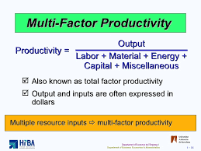
Managing Service and Manufacturing Operations

Slide 217
Managing Service and Manufacturing Operations
Quality – a product or service free of deficiencies, or the characteristics of a product or service that satisfy customer needs.
  Reliability
  Serviceability
  Durability
Notes:
I view Honda and Toyota as making high quality vehicles.
What firms do you view as high quality?

Slide 218
Managing Service and Manufacturing Operations
ISO 9000 – A series of five international standards, from ISO 9000 to ISO 9004, for achieving consistency in quality management and quality assurance in companies throughout the world.
ISO 14000 – A series of international standards for managing, monitoring, and minimizing an organization’s harmful effect on the environment.

Slide 219
Managing Service and Manufacturing Operations
Total Quality Management (TQM) – an integrated, principle-based, organization -wide strategy for improving product and service quality.
  Customer focus / Customer satisfaction (goals of TQM)
    Continuous improvement – focused on a reduction in variation.
    Teamwork (collaboration across business functions)

Slide 220
Managing Service and Manufacturing Operations
Service Operations
  Internal service quality – the quality of treatment employees receive from management and other divisions of a company.
  Service recovery – restoring customer satisfaction to strongly dissatisfied customers.

Slide 221
Managing Service and Manufacturing Operations
Manufacturing Operations
  Made-to-order
  Assemble-to-order
  Make-to-stock
Notes:
Made to order – some high end cars, tractors, designer gowns
Assemble to order – some degree of specialization such as options on cars, high end men’s suits
Make to stock – appliances, most clothes like jeans

Slide 222
Managing Service and Manufacturing Operations
Manufacturing flexibility – the degree to which manufacturing operations can easily and quickly change the number, kind, and characteristics of products they produce.
Continuous-flow operations – a manufacturing operation that produces goods at a continuous, rather than a discrete rate.
Line-flow production
Batch production
Job shops
Notes:
Continuous-flow operations - . (Enables higher production speed and output but reduces flexibility)

Slide 223
Managing Service and Manufacturing Operations
Inventory – the amount and number of raw materials, parts, and finished products that a company has in its possession.
  Raw materials
  Components parts
  Work-in-process
  Finished goods

Slide 224
Managing Service and Manufacturing Operations Inventory Considerations
  Average aggregate inventory
  Stockout
  Inventory turnover
  Ordering cost
  Setup costs
  Holding costs
  Stockout costs

Slide 225
Managing Service and Manufacturing Operations
Managing Inventory
Economic ordering quantity (EOQ)
Just-in-time – component parts arrive from suppliers just as they are needed at each stage of production. (lowers cost)
Kanban
Material requirement planning
Independent demand system – one type of inventory does not depend on another
Dependent demand system

Slide 226
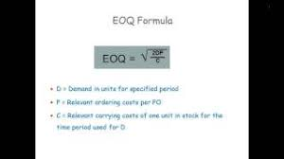
Notes:
Last slide prior to thank you.

Slide 227
Management 3070
Thank You!

